Slide 1
Barmetal national report – Denmark
Bengt Larsson
Lars Graadal

Slide 2
1 + 2 ”Settings” and Industrial relations syst.
Denmark is a small open economy dependent on exporting industries. Many small companies : Pharmacy, machinery and food products are large sectors, metal is moderate and automotive is small= in the semi-periphery of Eur automotive ind (Pavlinek 2021). Around 10-11 % of Danish employees are in manufacturing (incl. mining), which is close to the EU-27 mean
Denmark has a large welfare state based on social democratic traditions, however, as in other Nordic countries Denmark have seen the introduction of more liberal features, ”flexicurity”, ie. easy to hire/fire, but generous benefits/access to education for unemployed.
Danish trade unions are strong and are by tradition on an organized primarily on an occupational/industry basis, and previously three class-based confederations – but Blue- and white collar confederations merged in 2019 into FH/Danish TU conf.
TU density is 63% overall (58% in blue collar/private) – some ”yellow unions”. Collective bargaining coverage overall is 82% (priv sector 73%), appr 52% of enterprises have local union reps (single channel).
Industrial relations characterized by strong trade unions and employer associations negotiating bipartite collective agreements at sectoral level with adj locally = strong autonomy from state, but some tripartite corporatism in employment policies and vocational training).

Slide 3
3 policies and social dialogue shaping DAD
There is a very strong political and social partner commitment from Danish employers and unions regarding digitalization/automation, and also strong decarbonization ambitions → to stay ahead in development and stay competitive
General and sectoral collective agreements do not specifically regulate DAD, but, aspects such as further education/training, and H&S of course relates to this.
Social partners cooperate on ed/training, and have a joint Technology and cooperation committee (TEKSAM), which:
follow the technological development and support information, guidance and development work to promote cooperation in the companies, including the use of new technology (2020-23)
+ green transition is a central theme for TEKSAM in the coming years (2020-23)

Slide 4
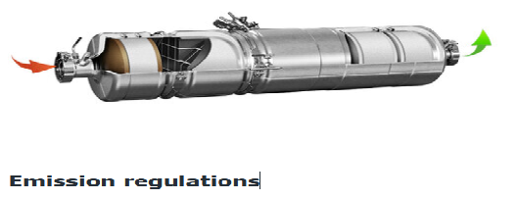
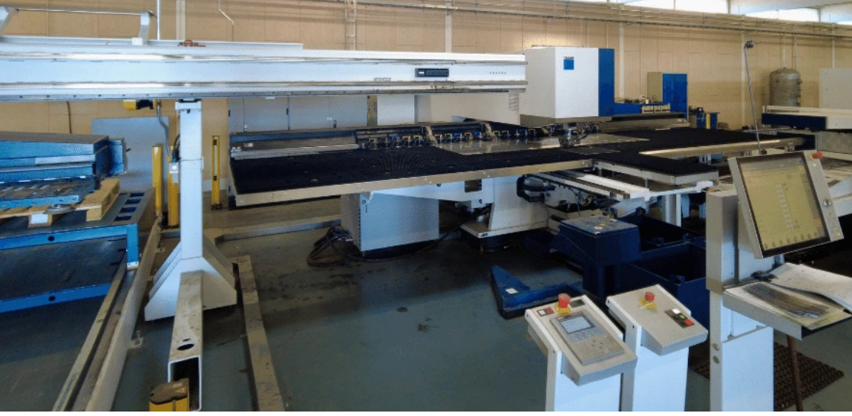
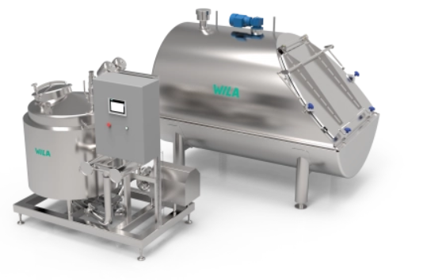
4-5 DK CASE STUDIES
Three company case studies and an additional interview with EO at sectoral level were used for the analysis.
Company 1: produces catalysts for combustion engines, with appr. 2000 employees. (highly automated) Interviews with HR-manager, sustainability manager, shop floor worker
Company 2. produces various things from atomatic luggage screening systems, to box systems for parcels (some automation) . Appr 400 employees in four plants. Interviews with HR-manager, Technical prod-Manager two shop stewards and a shop floor worker.
Company 3. produces steel equipment for food industries. (low level of automation). Appr 100 employees. Interviews with Int CFO, HR-manager, shop steward and shop floor worker.

Slide 5
DK Company case studies: Digitalization/Automation
All three companies use digital tech. in adm. Systems: finances, HR, and enterprise resource planning (ERP) systems, as well simple automation in production (Robotics/CNC machines).
The two larger have digitalized customer relations, and more advanced robots, and both aim for AI-based automation in the future
Main reasons for new technologies are straightforward: increasing productivity, cost efficiency and business expantion.. Robots/automation is also to increase quality, and improve production flow – and replace/release workers from monotonous tasks
Additional ”driving forces” are requirements from customers, and in “lower-level bottom-up improvements” suggestions from the employees.
Only in the largest company did local TU have a consultative role: BUT employees had some influence on implementation – because of experiences of failed implementation previously
Just as on sectoral level, local level TU reps seem to agree on the need for automation
Further education/training is the big local issue: send out their own knowledgeable workers + bring in education from the tech-supplier + one company finance external further education for 12 employees/year too “top up” their education/training as blacksmiths/technicians etc.

Slide 6
DK Company case studies: Decarbonization
Decarbonization is less developed in the companies The largest one (#1) has a formal sustainability policy since 2021. The smallest started its journey by completing its first Climate Report two weeks prior to the interview.
The companies are still only in their start-up process in relation to decarbonization,
but:
Company #1 producing catalyst have started producing a Fuel cell – to adapt to the decarbonization of vehicles.
Company #2, introduction of new more energy effective machinery and a planned installation of solar cells later this year
Company #3, have started to discuss both new machinery and solar cells.

Slide 7
6. Comparative: similar countries = DK+SE
DISSIMILAR: Automotive still large in SE, marginal in DK – Company sizes generally larger in SE as compared to DK
SIMILAR: employer and union consensus in the need for further DAD
DISSIMILAR less discussion of risks for employees/jobs in by Danish Tus as compared to Sweden: In Denmark D+A is thought to both keep/bring home plants/jobs and improve working conditions by reducing heavy and monotonous tasks.
SIMILAR: Decarbonization is thought to create jobs and improve competitiveness – and it is very much seen as part of the digitalization development
SIMILAR:. joint social partner cooperation on DAD is thought to benefit both companies, and employees and strengthen economic development
SIMILAR: DAD not specifically regulated in CAs (Sectoral level most important). BUT Education/training + H&S in CA are relevant in relation to DAD-consequences – and both are regulated sectorally, and often well-developed locally in both countries.

Slide 8
7. Comparative: Dissimilar countries DK/SE vs: HU/RS
Sorry if misrepresenting, and/or deemphasising exceptions!
DISSIMILAR:
DK+ SE strong Bipartite SO relations (UD+CA) at central, sectoral and union presence/dialogue at local level
←→ HU/RS weaker SP relations (some of Tripartite), particularly at Sectoral level (in metal), low union prescense at local level (though WCs), but Cas in some/large comp.
DK/SE strong commitment to DAD at both policy and in SP-cooperation/policy:
←→ HU/RS strong Digitalization agenda nationally, HU Weak Decarbonization agenda (RS stronger), and weak D-A-D engagement (by social partners) in social dialogue.
SIMILAR: More of DA than Decarbonization efforts in companies
Training/retraining offered (in some/big companies) – also assisted by suppliers/other org. (Different: In SE/DK also regulated by CA) otherwise DAD outside of SD/CA
Local union presence/ some consultation in case-companies, but not about DAD. Some employee influence in implementation of tech.

