Slide 1
JUSTMIG
Enhancing Integration of Temporary Migrant Workforce: Lessons from Slovakia
Martin Kahanec, Simona Brunnerová, Serhii Shokha
JUSTMIG Transnational workshop 15.11.2024 Bratislava

Slide 2
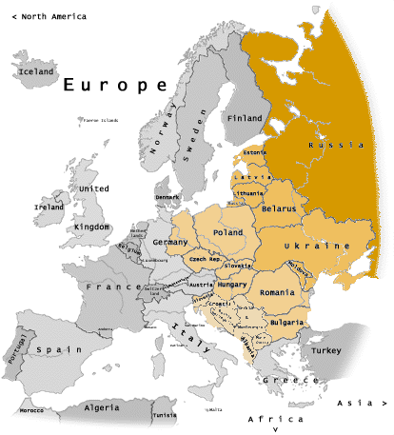
About us
Established in 2008 in Bratislava, Slovakia
Not-for-profit independent research institute, 20+ employees, 60+ fellows
CELSI strives to
Contribute to cutting-edge international scientific research
provide reliable and timely evidence for policy making
enable talent, build bridges between forefront international expertise and in-depth knowledge of local experts.
Focus on CEE in its applied work
RePEc: No. 54 think tank in the world

Slide 3
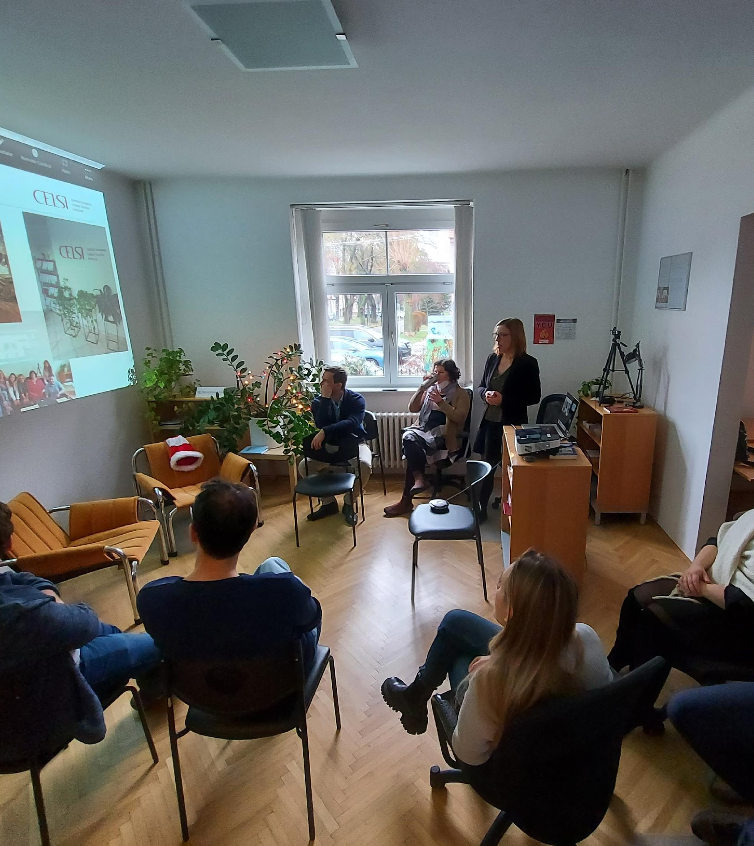
Research Areas
Labor Data and Measurement
Caring Societies
New Forms of Work
Labor Mobility
Inequalities and Vulnerabilities
Welfare and Labor Policy
Social Dialogue and Collective Bargaining
Green and Digital Transitions

Slide 4
Background report on Slovakia
Purpose: Examine trends and patterns of temporary labour mobility and employment of migrant workers on fixed-term or outsourced temporary contracts in selected manufacturing and service sectors in Slovakia.
Dynamics of temporary labour migration in Slovakia
Deepening the analysis on temporary labour migration and its relationship with changes in industrial relation structures
Methodology: Utilizes statistical analysis, policy review, desk research, and interviews.
Notes:
“The purpose of this report was to examine trends and patterns in temporary labor mobility and the employment of migrant workers on fixed-term or outsourced temporary contracts in selected manufacturing and service sectors in Slovakia.”
In recent years, Slovakia has seen notable shifts in labor mobility and employment, especially regarding temporary and migrant workers. This report delves into these trends, focusing on sectors where temporary labor is a critical component. By analyzing these patterns, we aim to understand the driving forces and implications of such employment structures in Slovakia’s workforce.
Temporary labor migration is influenced by both economic and policy changes, as well as evolving demands in the labor market. We explored how temporary contracts, often used for migrant workers, impact various sectors in Slovakia and how these dynamics play out across industries.
To provide a comprehensive view, we relied on a combination of statistical data analysis, reviews of current policies, desk research on existing literature, and interviews with key stakeholders.

Slide 5
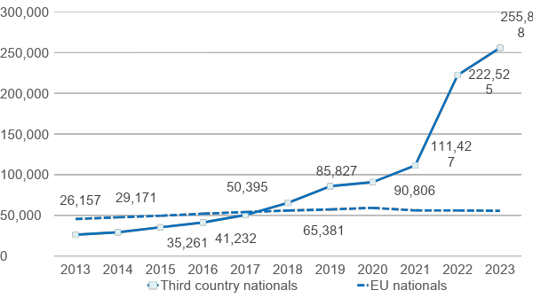
Migrants in Slovakia
Historically low, but growing. Fast track in 2022
Immigration is dominated by third-country nationals (80%)
Third country nationals (TCNs) in Slovakia:111,427 in 2021 and 255,898 in 2023 (residence permits)
War in Ukraine significantly increased the number of migrants
Notes:
Historically, Slovakia has had a relatively low rate of immigration. However, in recent years, this has been changing, with a rapid increase in migrant numbers, especially since 2022.”
In 2022, Slovakia saw a fast-track rise in immigration, marking a shift in its demographic landscape. We see an increased presence of third-country nationals, or TCNs—individuals from outside the European Union—who now make up 80% of migrants in Slovakia.
“If we look at the numbers, third-country nationals with residence permits have more than doubled in just two years: from 111,427 in 2021 to 255,898 in 2023.”
This surge is largely due to the war in Ukraine, which has pushed many to seek refuge and work in Slovakia. This influx presents both opportunities and challenges for the country's labor market and social policies.

Slide 6
Inflow of migrants
New origins: Vietnam, Philippines, Indonesia, Thailand, India, Serbia, Georgia, North Macedonia, Bosnia and Herzegovina, Moldova, Kyrgyzstan, Kazakhstan, Uzbekistan
Definition of temporary labour immigrants
first-time residence permits for employment reasons
shorter than one year
Temporary migrants dominant in construction, agriculture, food processing and social care.
Notes:
In addition to the traditional sources of immigration, Slovakia is now seeing new origins of migrants.”
Recently, Slovakia has experienced an influx of migrants from a more diverse range of countries, including Vietnam, the Philippines, Indonesia, Thailand, India, Serbia, Georgia, North Macedonia, Bosnia and Herzegovina, Moldova, Kyrgyzstan, Kazakhstan, and Uzbekistan. This broadening of migrant origins reflects changing labor needs and recruitment practices in Slovakia.
“Let’s clarify what we mean by ‘temporary labor immigrants’ in this context.”
Temporary labor immigrants are individuals granted first-time residence permits specifically for employment reasons, typically for contracts lasting less than a year. Many of these migrants fill essential but short-term roles within Slovakia’s economy.
“Temporary migrants are particularly dominant in sectors such as construction, agriculture, food processing, and social care.”
These sectors depend heavily on temporary workers to meet fluctuating labor demands, highlighting the crucial role that migrant labor plays in sustaining Slovakia's economy, especially in industries with seasonal or highly variable workloads.

Slide 7
Temporary protection holders (war refugees)
War refugees can be employed without work permit
Half of the refugees work in jobs below their qualifications, and a quarter with temporary small contracts (Veselkova and Habel, 2024)
Small contracts are flexible but provide lesser employee rights
Notes:
In Slovakia, war refugees—many of whom arrived due to the ongoing conflict in Ukraine—hold temporary protection status, allowing them to work without needing a formal work permit.”
This policy facilitates quicker integration into the workforce, enabling refugees to support themselves while contributing to the Slovak economy.
“Studies show that about half of these refugees are working in jobs that do not match their qualifications, while a quarter are on temporary small contracts (Veselkova and Habel, 2024).”
These small contracts offer flexibility, which may initially be attractive or necessary for refugees adjusting to a new country. However, they come with fewer employee rights and limited protections, which can impact workers' long-term stability and well-being. Ensuring that refugees can find roles aligned with their skills is essential to improve their integration and contributions to the workforce.

Slide 8
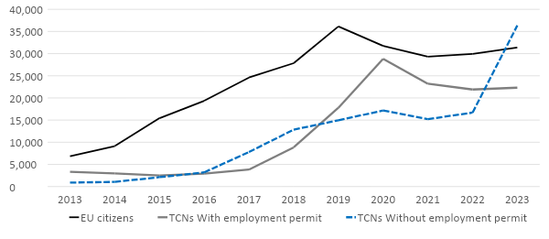
Foreigners working in Slovakia
TCNs need to apply for work permit
Short-term employment of up to 90 days does not require work permit
Source: Veselkova and Habel (2024). Data as of January 1 of the particular year. "With employment permit" refers to those employed on the basis of a work permit, single permit or EU Blue Card. "Without employment permit" refers to those employed without a work permit, single permit or EU Blue Card, pursuant to Article 23a of Act No. 5/2004 Coll.
Notes:
Data as of January 1 of the particular year. "With employment permit" refers to those employed on the basis of a work permit, single permit or EU Blue Card. "Without employment permit" refers to those employed without a work permit, single permit or EU Blue Card, pursuant to Article 23a of Act No. 5/2004 Coll.

Slide 9
Who are employed migrant workers
in the Slovak labour market?
Concentrated in manufacturing, transportation, administrative support, and food services, with a significant reliance on temporary work agencies. Often fill gaps in sectors facing labor shortages, such as healthcare, hospitality, and construction.
 | EU citizens | TCNs with employment permit | TCNs without employment permit
Number of employed migrants | 31,892 | 26,102 | 42,589
Women | 29% | 21% | 55%
Education
lower secondary | 48% | 24% | 31%
upper secondary | 26% | 38% | 35%
tertiary | 21% | 17% | 34%
Occupation
isco 1-3 | 31% | 11% | 17%
isco 4-7 | 27% | 21% | 26%
isco 8-9 | 42% | 68% | 57%
Employment duration (months)
1-6m | 8% | 2% | 22%
7-12m | 8% | 11% | 18%
13-24m | 11% | 48% | 31%
More than 2 years | 72% | 39% | 29%
Source: Based on statistics from Slovak employment office, 2023
Notes:
Who Are Employed Migrant Workers in the Slovak Labour Market?
“In Slovakia, migrant workers are a vital part of the labor market, particularly concentrated in sectors such as manufacturing, transportation, administrative support, and food services.”
Many migrant workers are placed through temporary work agencies, which helps to fill labor shortages in critical sectors like healthcare, hospitality, and construction. Migrant workers can be broadly grouped as follows:
EU Citizens
Third-Country Nationals (TCNs) with an employment permit
Third-Country Nationals (TCNs) without an employment permit—working under conditions allowed by Article 23a of Act No. 5/2004 Coll.
“Looking at the numbers, we see that there are 31,892 employed EU citizens, 26,102 TCNs with employment permits, and 42,589 TCNs working without permits.”
Let’s take a closer look at the demographic breakdown of these groups.
Gender: Women make up 29% of employed EU citizens, 21% of TCNs with permits, and a higher 55% of TCNs without permits.
Education: Among employed migrants, educational backgrounds vary significantly.
48% of EU citizens have a lower secondary education, while 26% have upper secondary, and 21% have tertiary education.
For TCNs with employment permits, 24% have lower secondary, 38% upper secondary, and 17% tertiary education.
TCNs without employment permits show a higher tertiary education rate of 34%, though 31% have lower secondary and 35% upper secondary education.
Occupation: When it comes to the types of jobs held:
In ISCO levels 1-3 (higher-skilled roles), 31% of EU citizens work in these jobs, compared to 11% of TCNs with permits and 17% without permits.
In ISCO levels 4-7 (skilled trades and similar roles), 27% of EU citizens, 21% of TCNs with permits, and 26% of TCNs without permits work here.
ISCO levels 8-9 (elementary occupations) are more common among TCNs with permits, who occupy 68% of these roles, compared to 42% of EU citizens and 57% of TCNs without permits.
Employment Duration: Duration also varies by group.
Most EU citizens (72%) stay for more than two years, as do 39% of TCNs with permits and 29% of TCNs without permits.
Shorter-term stays of 1–6 months are more common among TCNs without permits (22%) than other groups.
“This data shows the diversity and varied conditions under which migrant workers contribute to the Slovak economy, as well as some of the challenges they may face in accessing stable, long-term employment.”

Slide 10
Employment through temporary work agencies
Around 800 work agencies in Slovakia (450 active)
Some work agencies without a valid license
Precarious employment conditions (health insurance)
Problems with payments (non-payment of overtime)
Legal barriers to changing employer easily
Weak labour protection
Notes:
Temporary work agencies play a significant role in employing migrant workers in Slovakia, but the conditions of this employment often come with challenges.”
There are around 800 temporary work agencies operating in Slovakia, of which approximately 450 are active. However, some of these agencies are operating without a valid license, which poses serious risks to workers' rights and job security.
“Employment through these agencies is often characterized by precarious conditions.”
For instance, migrant workers employed through agencies frequently face issues with health insurance coverage. There are also common problems with payments, such as non-payment of overtime, which impacts their income stability. Additionally, legal barriers make it difficult for agency-employed workers to change employers easily, limiting their ability to seek better conditions.
“Overall, there is weak labor protection in this employment structure.”
Now we are going to tell you more about the findings we gathered through the interviews with migrants in Slovakia.

Slide 11
SLOVAKIA: interviewed Ukrainian workers in the care sector
Middle-aged women, with a diverse range of educational backgrounds from secondary to PhD.
Influx since 2022 due to the invasion; many arrived via evacuation routes, seeking financial stability and support for families; under EU temporary protection.
Most started with temporary, semi-legal, easily accessible work, often transitioning to the care sector thanks to personal connections.

Slide 12
SLOVAKIA: interviewed Ukrainian workers in the care sector
Regular temporary contracts directly with care-providing organizations, sometimes without immediate certification but with a requirement to complete necessary courses within the first months of work.
After the first or second renewal, contracts become permanent.
No observed discrimination; supportive relationships with colleagues; integration level varies from professional to informal friendships.

Slide 13
SLOVAKIA: interviewed Ukrainian workers in the care sector
Feelings of stability with limited career growth; preference to remain in the current sector even if changing jobs.
General satisfaction with income; many provide financial support to their family in Ukraine.
Some consider returning to Ukraine due to personal reasons or after war, but not due to dissatisfaction with life or work in Slovakia.

Slide 14
SLOVAKIA: interviewed Serbian workers in the automotive sector
typically secondary school, middle-aged males
2016 a watershed: appeared on the Slovak labour market, since 2020 fewer (also comparatively among migrant workers)
employment trajectory: from illegal/semi/legal to permanent contracts (via temp agencies, fixed term contracts) but if on permanent contracts, at the bottom of the company hierarchy (production line workers).
precarious position, insufficient incomes etc.
for long-term planning: considering return home or starting new cycle of migration
marginalised social group, some critical of trade unions

Slide 15
Overall Evaluation
Complex and sometimes contradictory approach to migration in Slovakia
Economic Imperative vs. Social Resistance: Much demand for migrant labor, particularly in sectors with labor shortages. Yet, generally negative perception of migration, shaped by historical isolation from major migration waves and limited exposure to foreigners.
Integration Barriers and Dependency: Limited infrastructure for integration and reliance on temporary work agencies increase migrant dependency on employers, often restricting their social mobility and exacerbating marginalization.
Selective Support: Slovaks show higher acceptance of culturally similar, skilled migrants and those fleeing from a conflict (e.g. Ukrainians). However, societal friction exists, particularly when benefits and social support measures are perceived to favor migrants over locals.

Slide 16
Migrant workers’ experiences
Stable integration with positive workplace relationships: Ukrainian care workers report supportive, mostly non-discriminatory environments, feeling secure in their jobs and forming both professional and personal bonds with colleagues, despite limited career growth opportunities.
Financial stability and commitment to family support: The interviewed workers achieve financial satisfaction, allowing them to support families in Ukraine; while some may consider returning post-war, this is based on personal factors rather than dissatisfaction with their roles in Slovakia.

Slide 17
THANK YOU FOR YOUR
ATTENTION!
martin.kahanec@celsi.sk

