Slide 1
Worker migration to Hungary and industrail relations
Bargaining for working conditions and social rights of migrant workers in CEE Countries (BARMIG)
Agreement number: VS/2020/0119
Tibor T. Meszmann
Central European Labour Studies Institute
tibor.meszmann@celsi.sk
Kick-off Meeting, October 7. 2020. 29.

Slide 2
Labour market situation
“tight” labour market - especially since 2016 rising labour shortages
Until COVID: High activity rate, but workfarist policies (since 2010)
Migrant workers present in:
- cost sensitive sectors (traditional): agriculture, construction, increasingly manufacturing
Export oriented economy (manufacturing), in need of flexible workforce – migrants present in 2016
Covid: major shock

Slide 3
Data / pre COVID. Number of issued work permits and registrations by counties. Last data, 2019. Non-EU citizens. Source: https://nfsz.munka.hu/tart/stat_kulfoldiek

Slide 4
2018 individual and joint permit – numbers, by countries NFSZ 2019

Slide 5
Employer registered employees foreign nationals by country, 2018, NFSZ, 2018

Slide 6
Issued work permits by main sectors, 2018
Construction
Manufacturing
Health and social support
retail
Tourism
Transport, storage

Slide 7
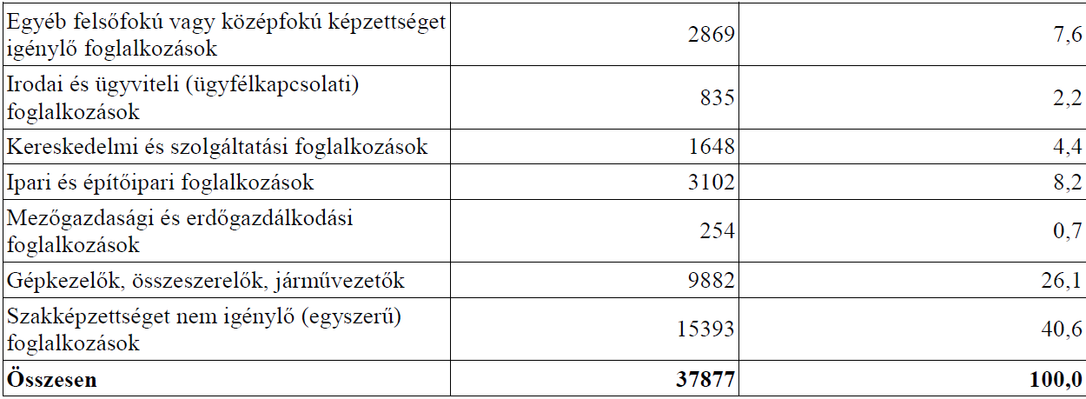
Issued permits by main occupation groups 1-9, 2018 (SOC) Hierarchy. Two thirds in low-skill groups (esp.9)
1: managers, directors and senior officials 2: professional occupations 3: associate professional and technical occupations 4: administrative and secretarial occupations 5: skilled trades occupations 6: caring, leisure and other service occupations 7: sales and customer service occupations. 8: process, plant and machine operatives 9: elementary occupations

Slide 8
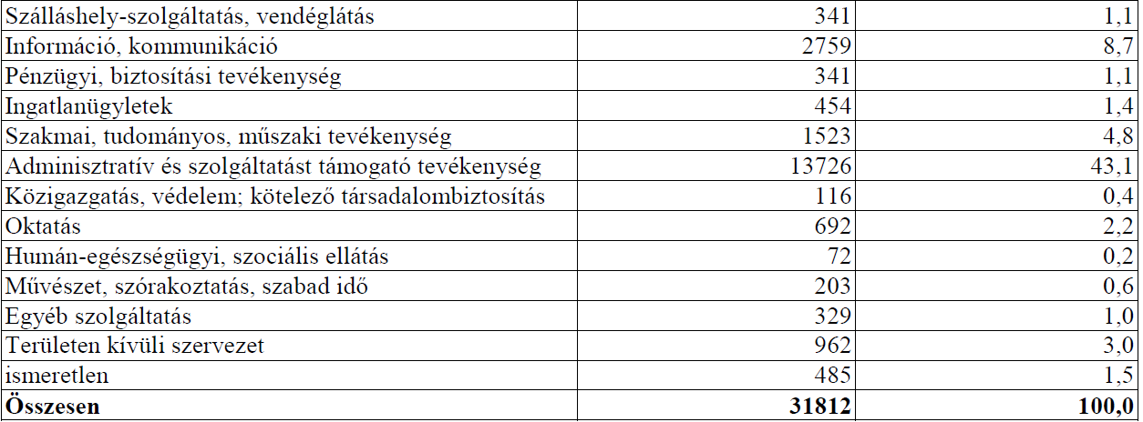
Employer registered foreign citizen employees by sectors, and distribution 2018

Slide 9
Employer registered foreign citizen employees by main occupation group 1-9, and distribution 2018

Slide 10
Data quality - problems
Problems: static, workforce inflow based and incomplete!
Only a flow data: stock not available (would be needed)
Intermediate control factors: outmigration, circular migration, naturalisation not taken into account
Since 2017 at least it does not show temporary work (up until 90 days)
Self-employed – ‘small entrepreneurs’…
... and illegal work
Advantage:
shows a trend
Disaggregated data
Dynamic Statistical data on migration in Hungary available since 1990s, Annual reports of KSH, based on data of Ministry of Interior (Hárs). Registers also persons getting Hungarian citizenship
For better judgment of numbers one needs to account multiple sources:
Administrative data - sources: various ministries, administrative and regulatory bodies, social security system, tax database, reports of recruitment agencies.
Statistical data sources household surveys, (foreign born employees), company registers, border crossing statistics (Hárs 2008 based on )
In depth regional- territorial migration methodologies: starting with ‘territoral networks of migration’ Kincses 2020 (can be used)

Slide 11
Employment rate by settlement types, migrant workers, local workers, 2011, 2017 (Kincses 2020)

Slide 12
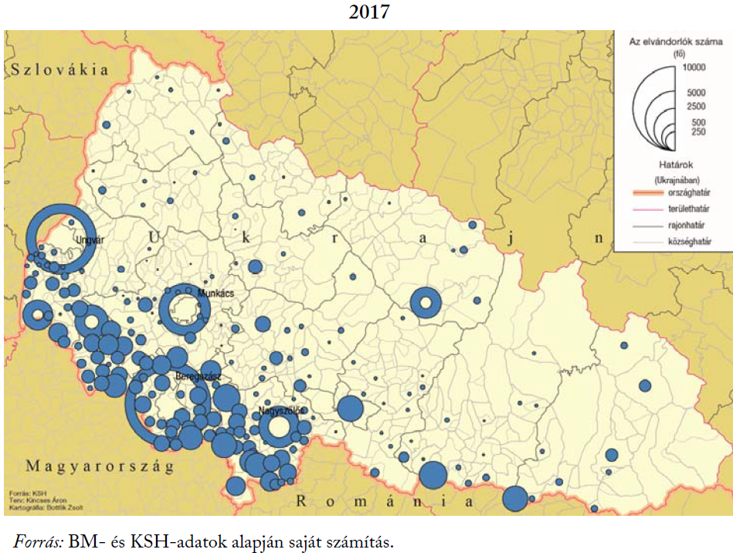
Migration to Hungary – Ukrainian territorial sources, 2011, 2017 Source, Kincses 2020: 59

Slide 13
Migration to Hungary – Ukrainian territorial sources, 2011, 2017 Source, Kincses 2020: 62

Slide 14
Employment of third country national - with Covid
Among first to lose jobs – in some sectors (e.g. automotives), or under extreme pressure – exposed vulnerabilities (deteriorating income, relative wage, lost subsistence – extra-wage benefit)
Return of third country citizens in some sectors in the autumn (e.g. automotives, electronics)

Slide 15
Secondary literature, Hungary
Political economy – migration specialists (esp Melegh, A.) Few studies on sectors / companies – global value chain analysis, sourcing of labour – expanding labour markets (e.g. Meszmann and Fedyuk 2019)
Migration specialists, including work related. E.g. Rédei, Kincses, Á 2020, Hárs, 2016. Extensive statistical and territorial data on work related migration since 1990s. Annual statistical yearbooks and especially census data!
History of worker migration and labour market position – but sectoral accounts few (e.g. Construction – open labour market at moszkva tér in Budapest, Sík 1996)
Reports of NGOs (Menedék, etc.) on labour market position of third country citizens

Slide 16
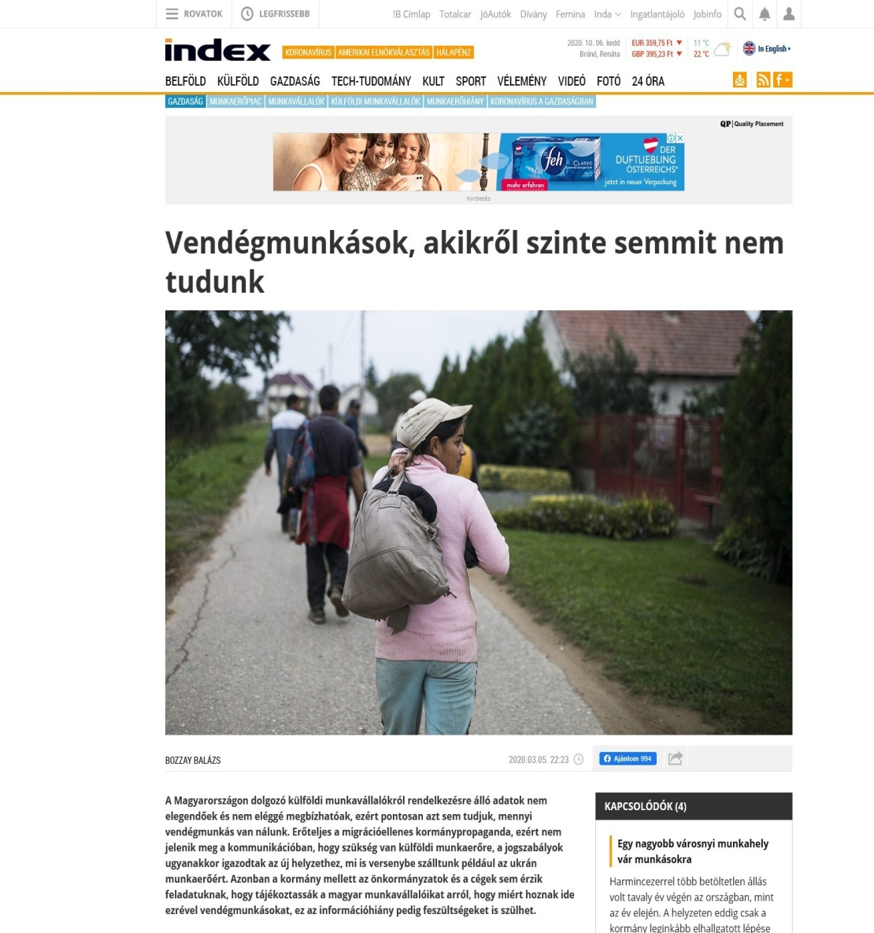
Media: right wing, protectionist connotations, and discourse on ‘guest-workers’

Slide 17
Labour market integration
For „Low” skilled workers: Very low integration level– circular or temporary work related migration- OR naturalisation strategies – higher chance
No or very sporadically available channels of interest representation

Slide 18
Regulation. Work permits to third country citizens
Law no. 4/1991 regulates employment promotion and care for the unemployed but also employment of foreign nationals. A quota system applies, and job openings for skills-professions that are scarce-unavailable. Main rules is that third country citizens can be employed only with permission from respective bodies – decrees outline exemptions. Third country citizen is a person who does not have residence permit – i.e. a foreign national and an apatrid. Since 2009, EU+ nationals and their spouses also do not require work permits. Employers only need to register it
Governmental decree No. 355/2007. (XII. 23.) regulating free movement of labour with EU residency, as well as rules, procedures related to obtaining work permission for third country nationals, rules of employment - exemptions from work permissions
Governmental decree No. 445/2013. (XI. 28.) Exemptions from obtaining work permits of third country nationals in Hungary and remuneration
Special treatment of Ukrainian and Serbian citizens
From July 2017. Ukrainian and Serbian citizens. No work permission visa needed for employment lasting not more than 90 days.

Slide 19
Employment forms and Social partners role
In „low” skilled occupations: temporary agency work on the rise – subcontracting. Platformisation on the rise...
OR shady employment practices (e.g. Construction)
For high skill – e.g. Healthcare – no data, but most likely high integration
In off-line platform work, also present third country nationals

Slide 20
Industrial relations: Employer organisations and trade unions. Capacities and strategies
Employer organisation formally lobbied for import of workers from culturally close countries – plus easing regulation (since 2017)
Among employer organisations also association(s) of temp agencies, that increasingly participated in regulation and its implementation
Trade unions. Strategy until 2010: mostly to limit the number of migrant workers to set numbers
In general have low capacities and integration of migrant workers does not feature on their agenda
Or: even hostile to-closed to migrant workers (in sectors that are vulnerable to shocks, such as automotives)

Slide 21
Industrial relations in COVID times...
Experienced a further shock – labour law assaulted
Collective bargaining typically do not deal with integration of migrant workers. With Covid: many collective agreements are terminated
Trade unions’ position weakened further…
But probably also of employer associations

Slide 22
suggested interviewees
At least 2 interviews per 4 sectors (i.e. 8): construction, retail (warehouse logistics), automotives, healthcare
Employer federations
Trade union federations
Temp agencies
Platform economy: support organisations
Experts on labour migration and integration

Slide 23
Literature (initial)
Annual reports on foreign workers in Hungary (data since 2009) - nfsz.munka.hu/tart/stat_kulfoldiek
Bertalan B. (1997). Feketemunka Imortból, Avagy a Hétköznapi Diplomácia Eredete, in: E. Sík, J. Tóth (eds), Migráció és Politika, pp. 121–135. Budapest: MTA Politikai Tudományok Intézete Nemzetközi Migráció és Munkaügyi Kutatóközpont.
Feischmidt M., Zakariás I. (2010). Migráció és Etnicitás. A Mobilitás Formái és Politikái Nemzeti és Transznacionális Térben, in: M. Feischmidt (ed.), Etnicitás. Különbségteremtő Társadalom, pp. 152–169. Budapest: Gondolat, MTA Kisebbségkutató Intézet
Gödri I. (2011). Nemek Közötti Eltérések a Külföldi Allampolgárok Munkaerő-Piaci Helyzetében Magyarországon, in: I. Nagy, T. Pongrácz (eds), Szerepvaltozasok. Jelentes a Ferfi Ak es a Nők Helyzeteről 2011, pp. 88–112. Budapest: TÁRKI–Nemzeti Erőforrás Minisztérium. Central and Eastern European Migration Review 91 Gödri I., Soltész B., Bodacz-Nagy B. (2014). Immigration or Emigration Country? Migration Trends and Their Socio-Economic Background in Hungary: A Longer-Term Historical Perspective. Budapest: Hungarian Demographic Research Institute.
Hárs Á. (2010). Migráció és Munkaerőpiac Magyarországon. Tények, Okok, Lehetőségek, in: Á.
Hárs, Á, J. Tóth (eds), Változó Migráció – Változó Környezet, pp. 15–53. Budapest: MTA Kisebbségkutató. Hárs Á. (2016). The Experiences of a New Emigrant Country: Emerging Migration from Hungary, in: M. Kahanec, K. Zimmermann (eds), Labor Migration, EU Enlargement, and the Great Recession, pp. 271–296. Berlin, Heidleberg: Springer-Verlag.
Juhász J., Csatári F., Makara E. (2010). ‘Ukrán Allampolgárok Munkavállalása Magyarországon’: Záró Tanulmány. Budapest: Panta Rhei Társadalomkutató Bt.
Kincses, Á. (2020) A nemzetközi vándorlás területi hálózatai a Kárpát-medencében. Budapest, KSH
Langerné Rédei M. (2011). Ukrán Munkavállalás Magyarországon, in: Á. Kincses (ed.), Ukrán Allampolgárok Magyarországon, pp. 70–90. Budapest: Európai Integrációs Alap.
Melegh A. (2011). A Globalizáció és Migráció Magyarországon. Educatio 2: 166–180. Melegh A. (2016). Unequal Exchanges and the Radicalization of Demographic Nationalism. Intersections. East European Journal of Society and Politics 2(4): 87–108
Meszmann, T. T and Fedyuk O. (2019) ‘Snakes or Ladders? Job Quality Assessment among Temp Workers from Ukraine in Hungarian Electronics. Central and Eastern European Migration Review 8(1): 75-93
Pakurár M., Oláh J., Cehla B. (2012). Az ukrajnai munkavállalók munkavállalási jellemzői Magyarországon. Gazdálkodás 56(2): 1–9
Sík, E. (2006) „Emberpiac a Moszkva téren: szűkülő változatlanság 1995 és 2004 között. Közgazdasági Szemle Vol. 53 March pp. 253-270
Soltész B., Erőss Á., Karácsonyi D., Kincses Á. (2014): Hungary: Cross-Border Migration in a Fragmented Ethnic Space, in: Á. Erőss, D. Karácsonyi (eds), Discovering Migration between Visegrad Countries and Eastern Partners, pp. 72–87. Budapest: HAS Geographical Institute.

