Slide 1
BARMETAL Analysis of European CBAs in the Metal sector
Final conference: 20-09-2024
Gabriele Medas
Global Manager of the WageIndicator Collective Agreements Database
gabrielemedas@wageindicator.org
Digitalization, Automatization and Decarbonization: Opportunity for Strengthening Collective Bargaining in the Metal Sector.
BARMETAL. (Project Code: SOCPL-2021-IND-REL).

Slide 2
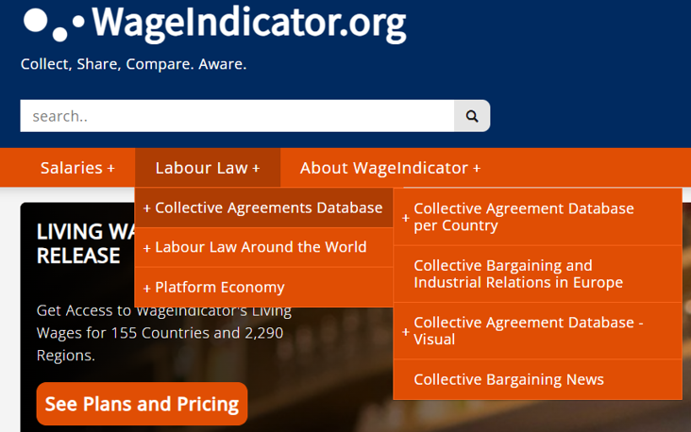
The WageIndicator Collective Agreements Database in numbers
Established in 2012
Currently hosting around 3000 CBAs from 70 countries all over the world, in 28 languages
Agreements are collected and annotated (coding scheme with more than 1000 variables) and published in WageIndicator national websites, all in national languages (original text)
All CBAs are internationally comparable (largest international database of the world)
12 main macro-topics

Slide 3
Collecting, annotating and coding agreements
THE MACRO TOPICS CODED IN THE DATABASE
Job titles
Individual employment contracts / job security
Social security and pensions
Work-life balance arrangements
Equality and/or violence in the workplace
Wages
New Technologies & Green clauses
Working hours, schedules, holidays and days of leave
Workers’ Representation & Conflicts
Training / apprenticeship
Health and medical assistance
Sickness and disability

Slide 4
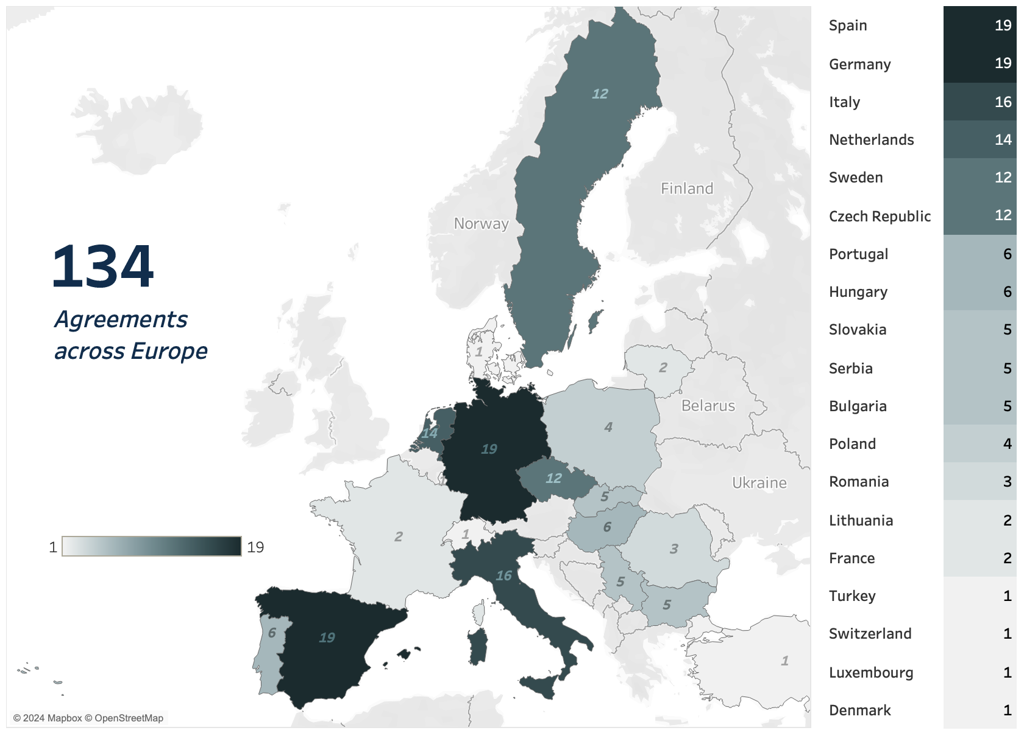
Global map of the European metal sector CBAs analysed for BARMETAL
134 CBAs in 19 countries
Spain, Germany, Italy, the Netherlands, Sweden and Czechia stand out as the top countries with the most metal sector CBAs in our sample (19-12)

Slide 5
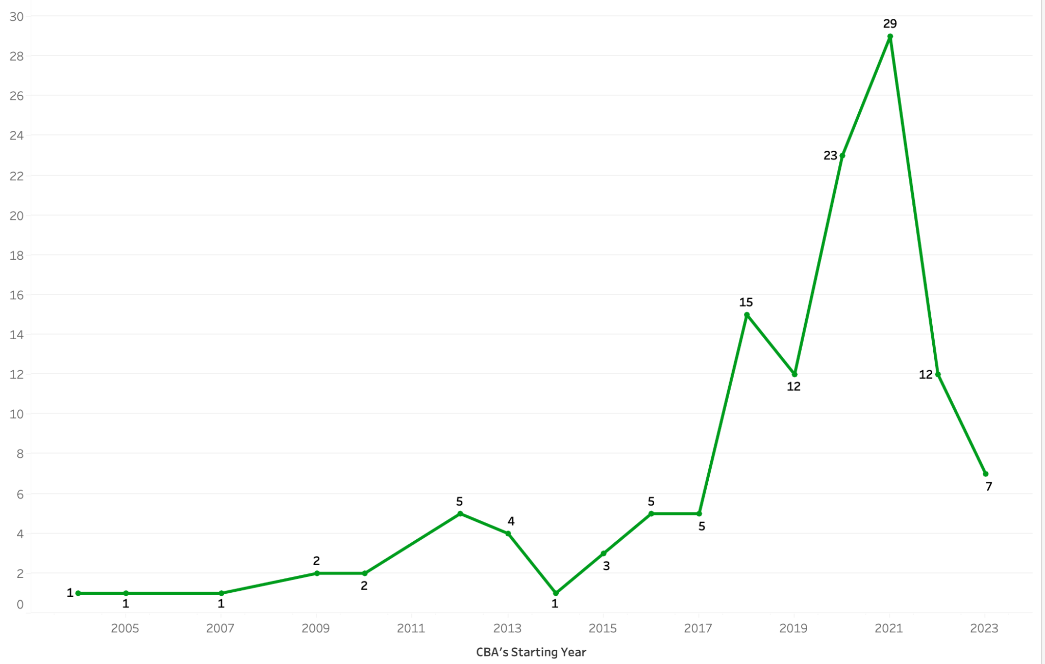
NACE Codes and Time range of the CBAs involved in the analysis
2400 | Manufacture of basic metals
2500 | Manufacture of fabricated metal products, except machinery and equipment
2600 | Manufacture of computer, electronic and optical products
2700 | Manufacture of electrical equipment
2800 | Manufacture of machinery and equipment
2900 | Manufacture of motor vehicles, trailers and semi-trailers
6 Metal NACE Codes (2400-2900)
The time range of all the CBAs covers the years from 2005 to 2023
The sample is quite recent, as most of the CBAs were signed between 2017 and 2023
Most of the CBAs (29) were signed in 2021

Slide 6
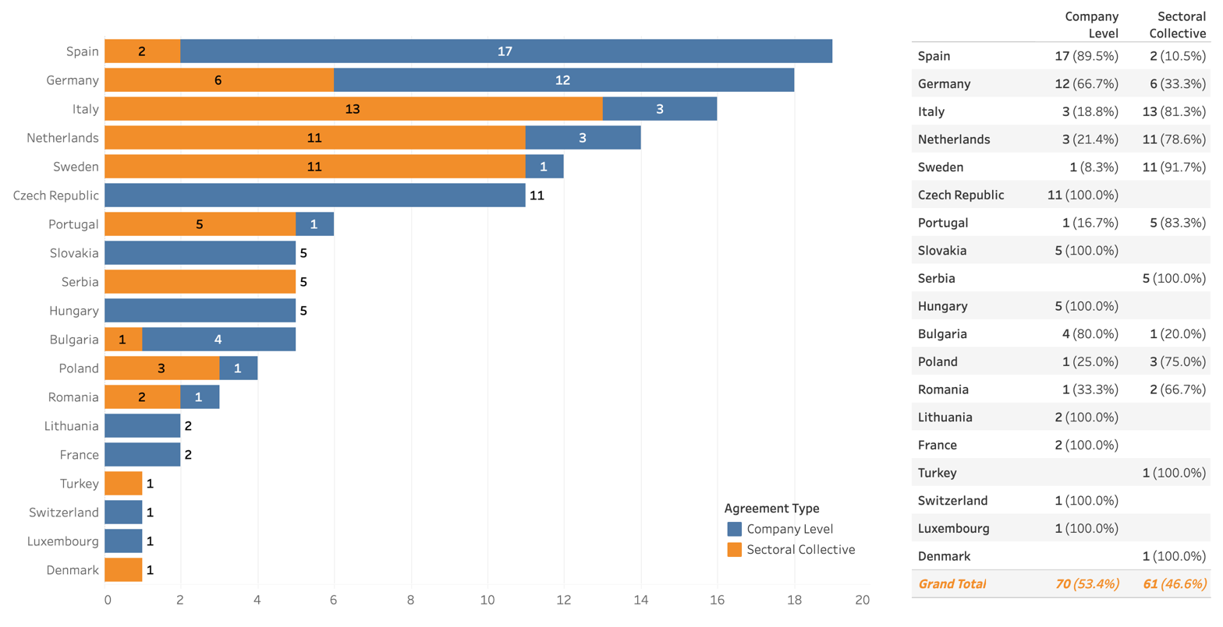
Distribution of the sample: Sectoral and Company level CBAs per country
A very balanced sample (almost equally divided)
53% company level (blue)
47% sectoral level (orange)
Spain, Germany, Czechia, Slovakia and Hungary are significally represented with a majority of company level CBAs
Italy, Sweden, Portugal and Serbia, on the hother hand, with a majority of secoral CBAs

Slide 7
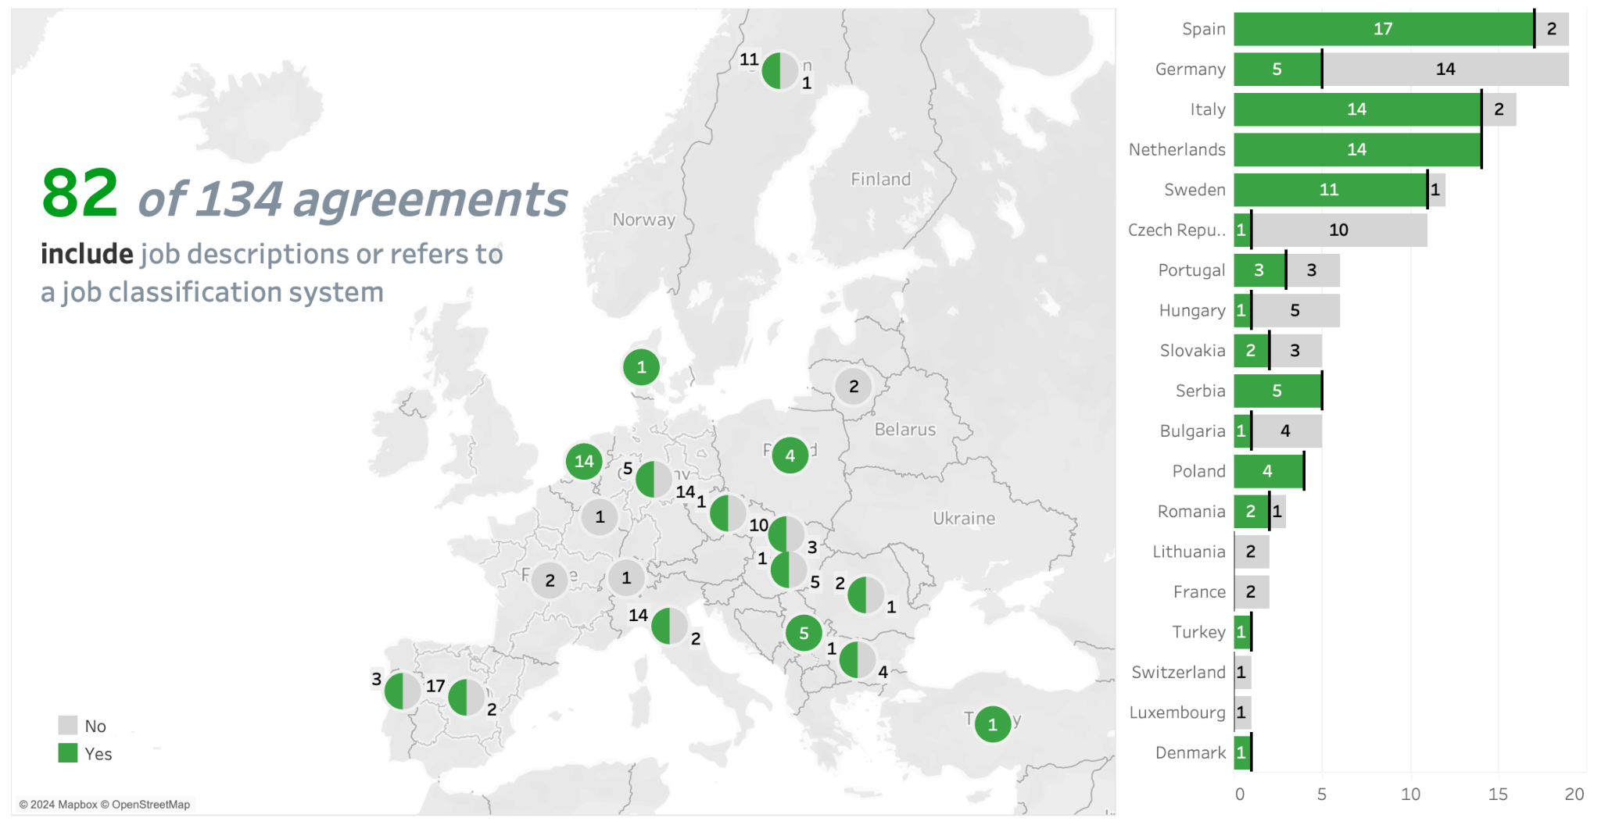
Job descriptions and job classification system
82/134 CBAs refer to clauses related to this topic (61%)
Spain, Italy, Sweden, Serbia, Poland and the Netherlands are the countries with more CBAs (highest rate) referring to such clauses

Slide 8
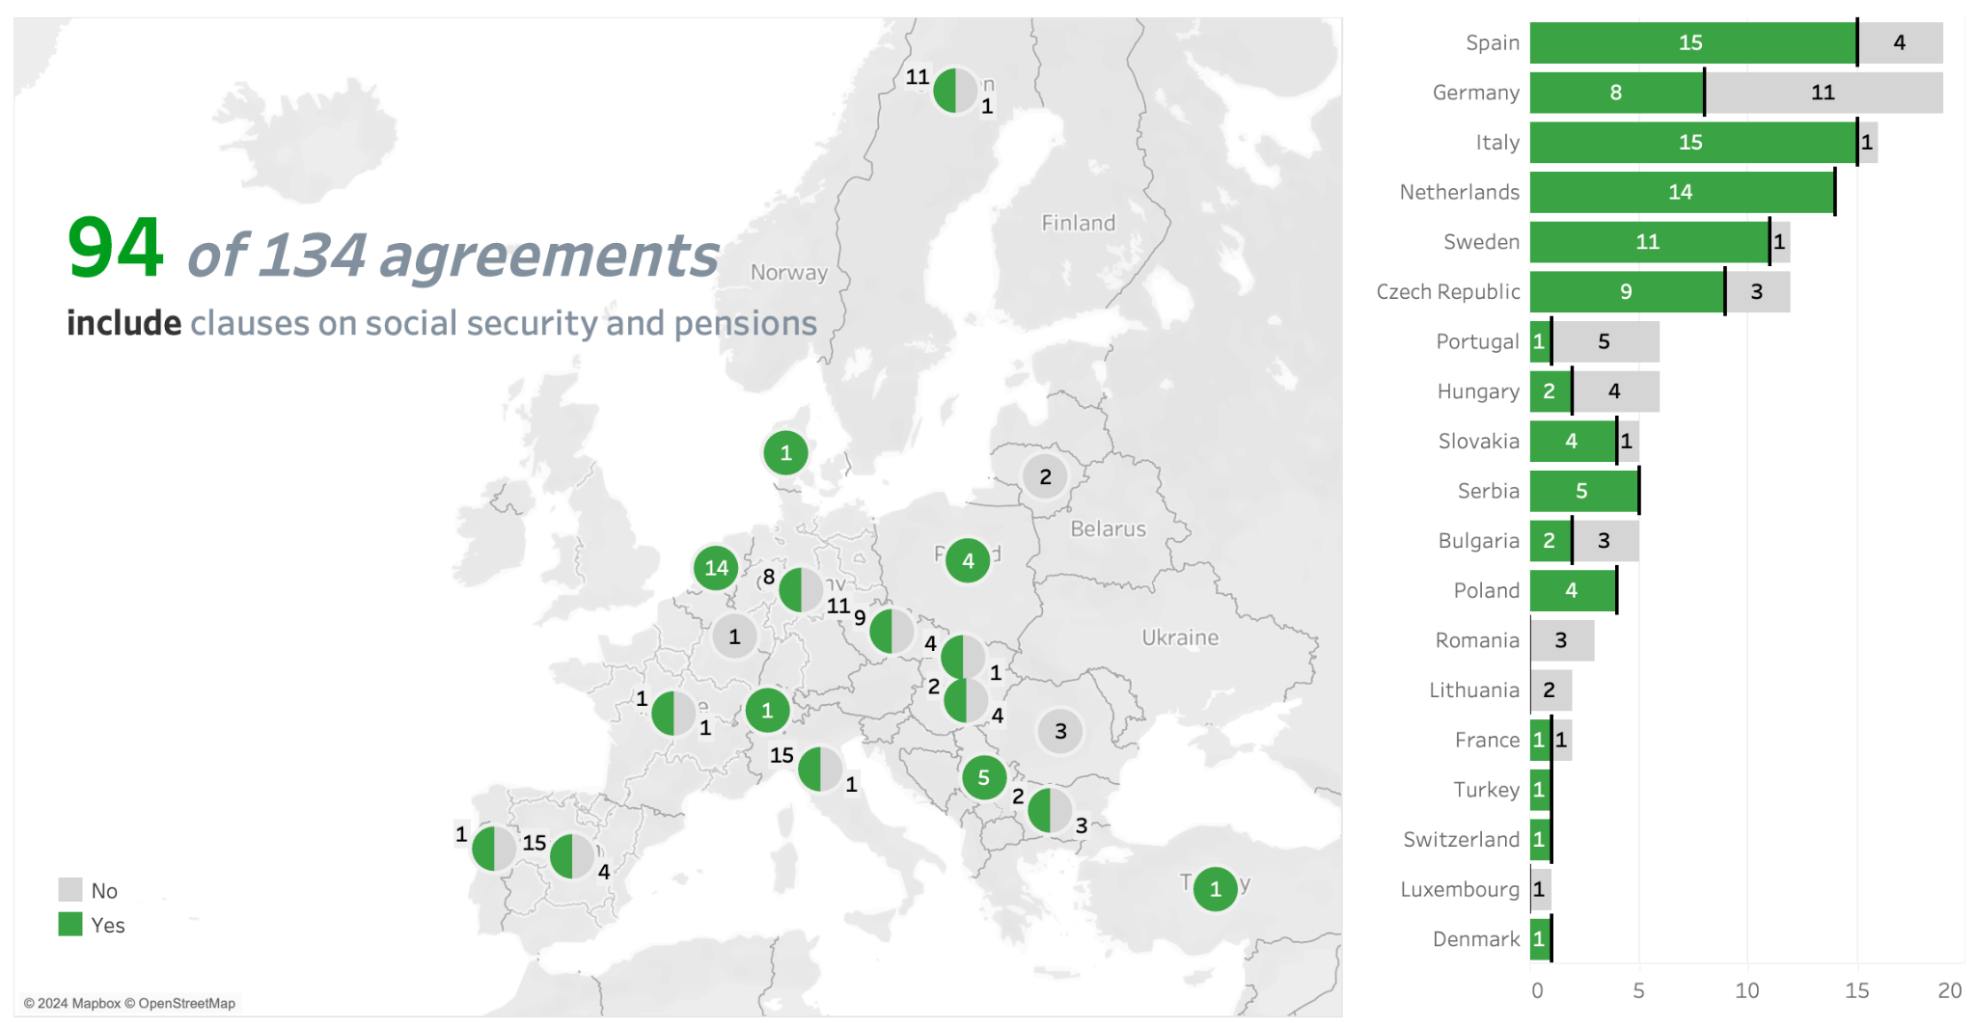
Social security and pensions
94/134 CBAs refer to clauses related to this topic (70%)
Among the countries with more CBAs mentioning such topic : Dutch, Italian, Spanish and Swedish CBAs provide for such clauses in almost all their CBAs
All the Serbian CBAs (5) and Polish CBAs (4) have clauses regarding such topic

Slide 9
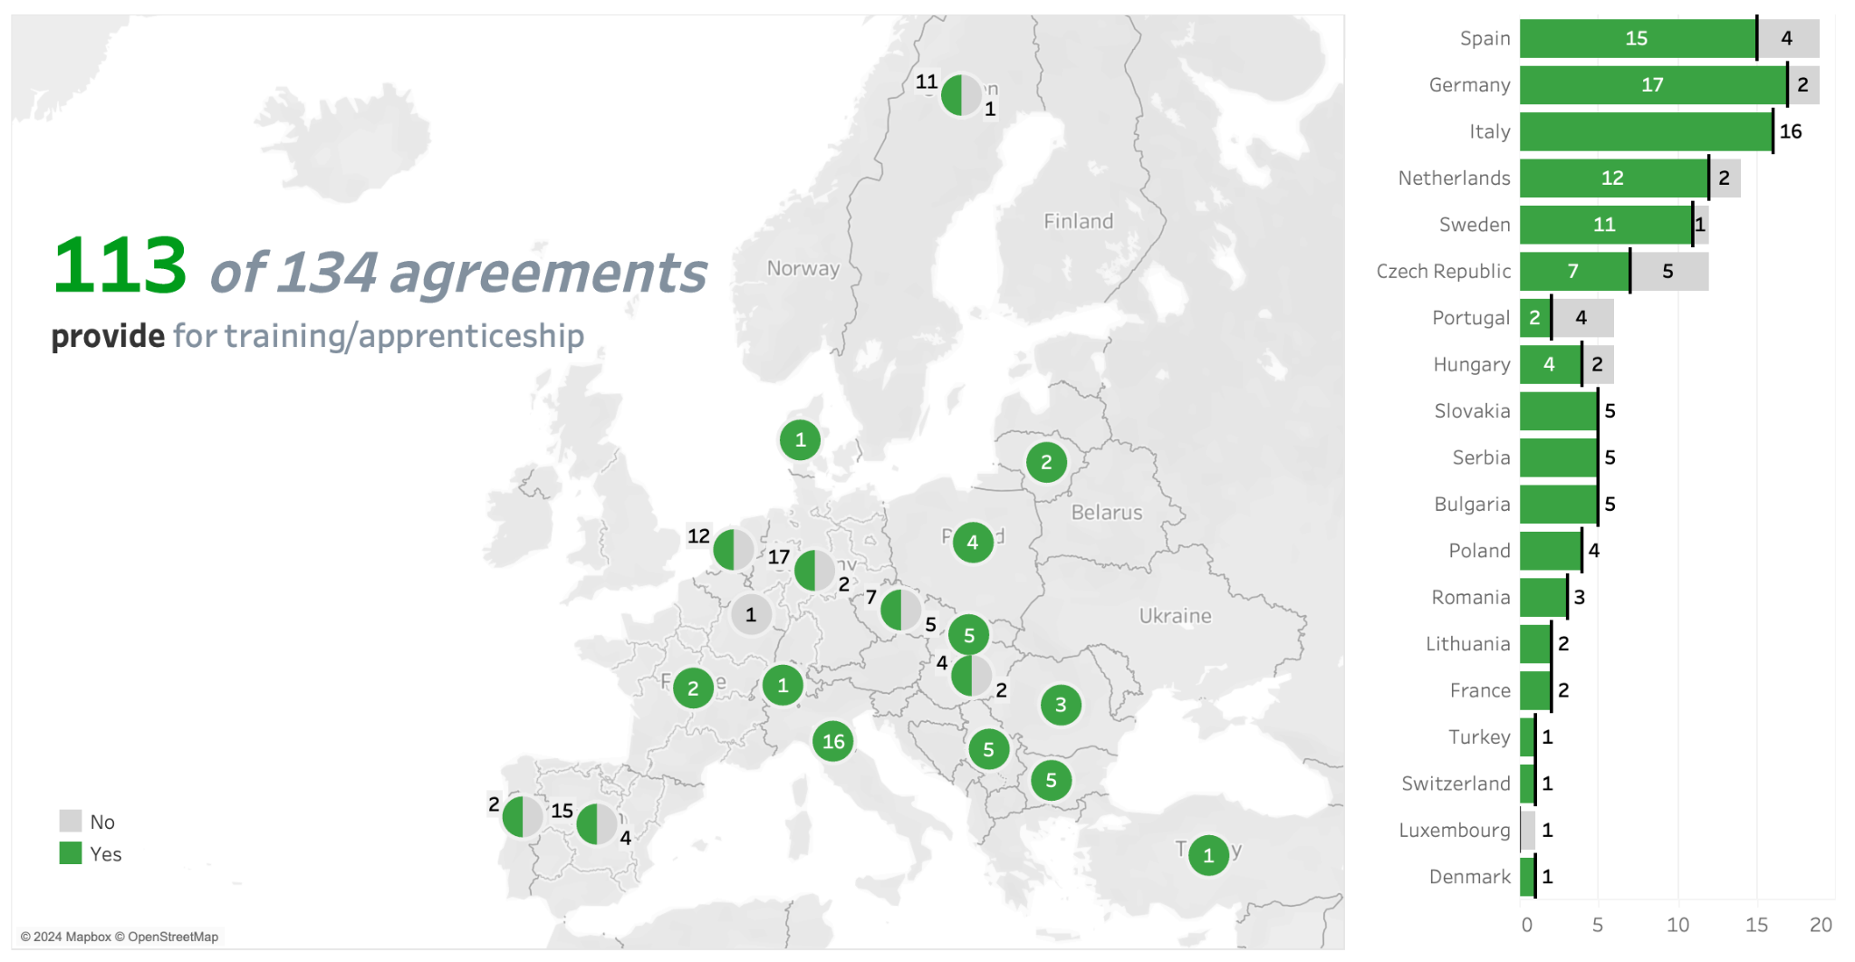
Training and Apprenticeship
113 of 134 CBAs refer to clauses related to this topic
The vast majoriy of the CBAs provive for such clauses, with an overall 85% of coverage

Slide 10
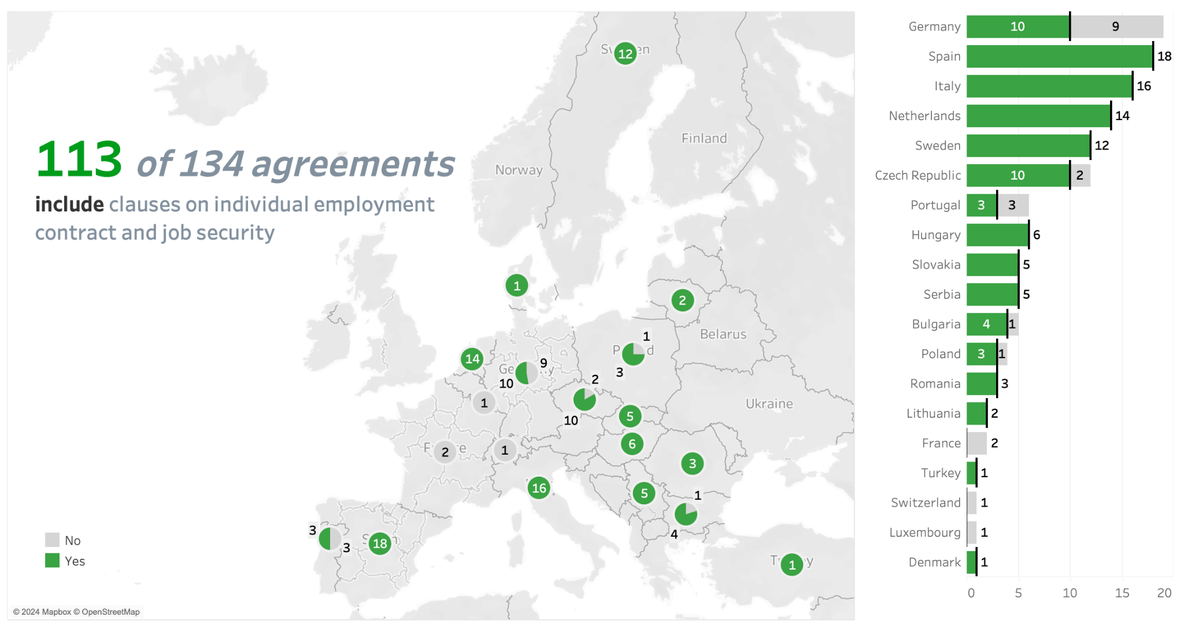
Employment contracts and job security
113 of 134 CBAs refer to clauses related to this topic
Most of the European metal CBAs (85%) of the sample cover such topic
All the Spanish, Italian, Swedish and Dutch CBAs contain such clauses (100%), among the countries with more CBAs

Slide 11
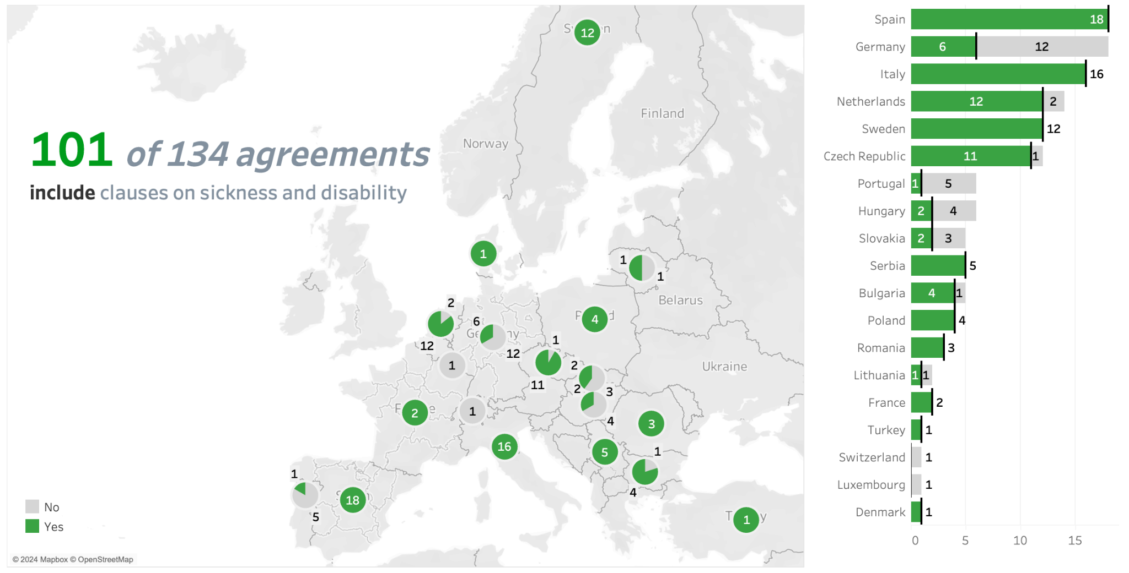
Sickness and disability
101 of 134 CBAs refer to clauses related to this topic
Overall, 75% of the CBAs contain such clauses
CBAs from Spain, Italy, Sweden, the Netherlands and Czechia contemplate such topic in almost all their agreements
Similarly, Serbia, Poland and Romania include the topic in ALL their agreements.

Slide 12
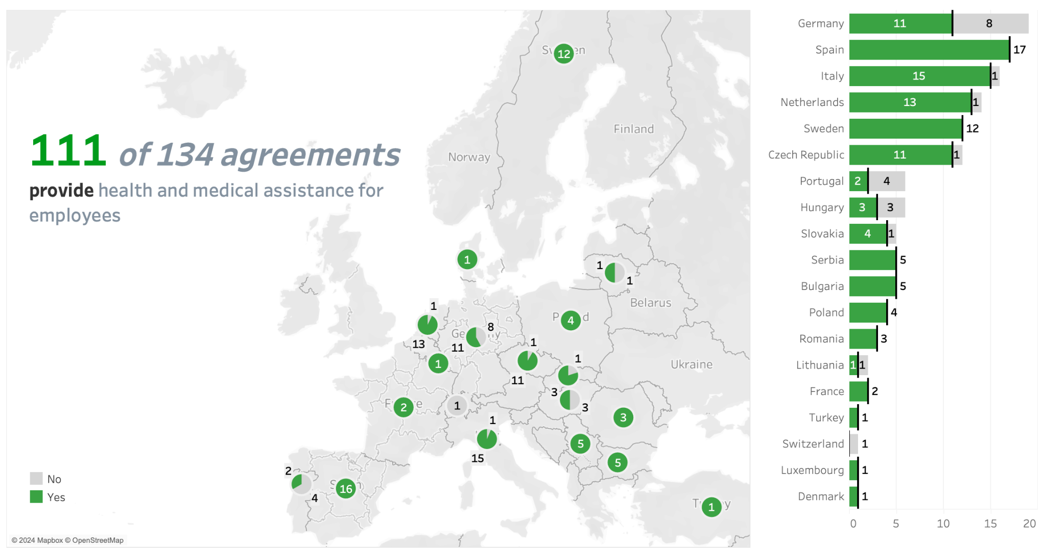
Health and medical assistance
111 of 134 CBAs refer to clauses related to this topic (83%)
Overall, all the targeted countries contain such clauses in their agreements.

Slide 13
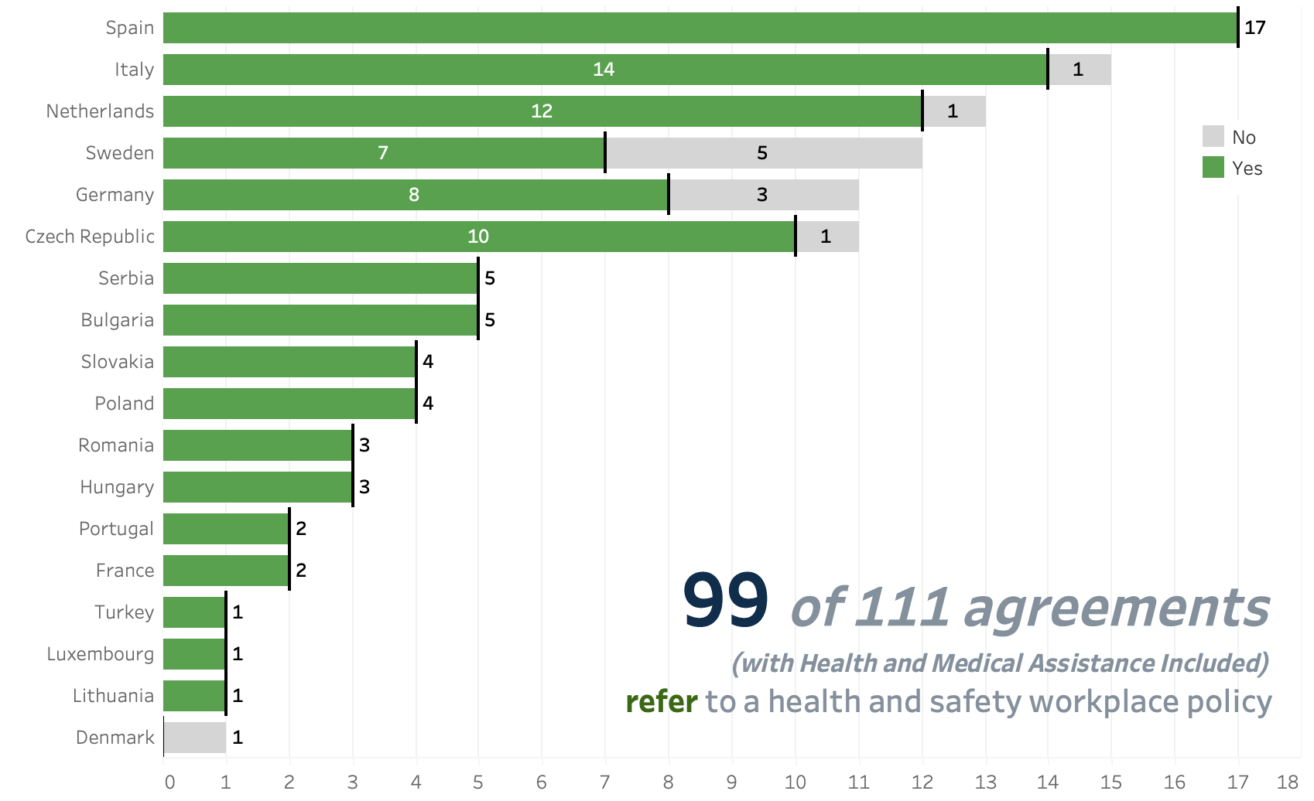
Health and safety workplace policy
99 of 111 CBAs refer to clauses related to this specific topic
This means that 90% of the CBAs refer and comply with an official health and safety policy document

Slide 14
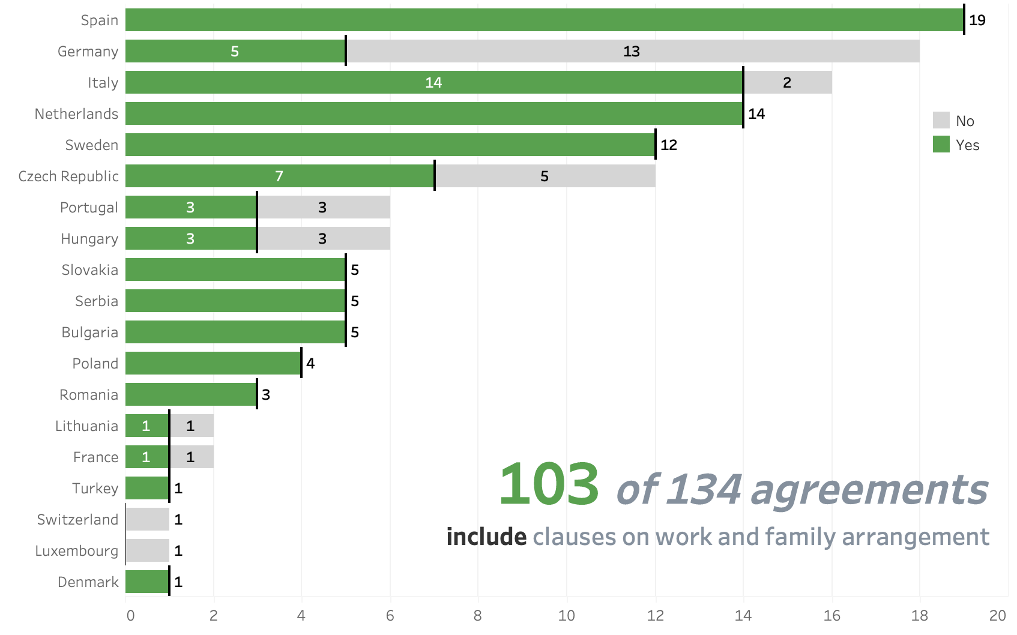
Work and family arrangements (including pregnancy, maternity/paternity leave and childcare)
103 of 134 CBAs refer to clauses related to this topic (77%)
10 countries contain such clauses in ALL their agreements.
17/19 countries contain such clauses in their CBAs

Slide 15
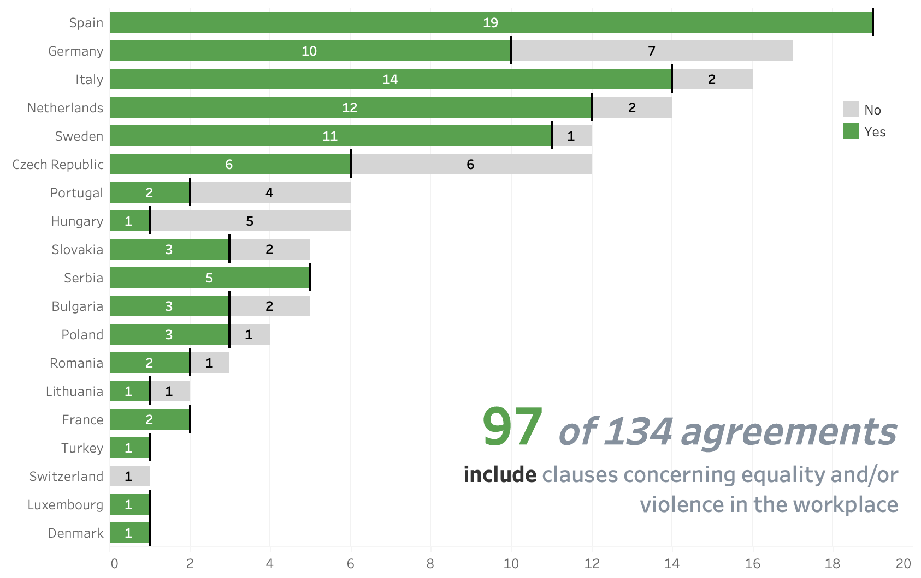
Gender equality issues
97 of 134 CBAs refer to clauses related to this topic (72%)
CBAs from Spain, Italy, Sweden, Netherlands and Serbia have the highest percentage of CBAs that include such clauses

Slide 16
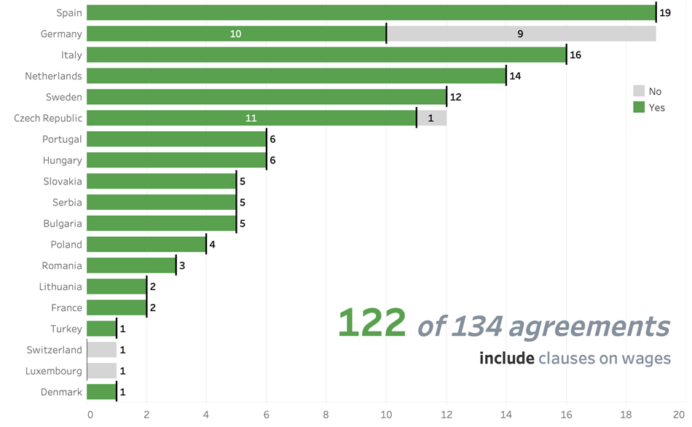
Wages
122 of 134 CBAs refer to clauses on Wages
Hence, 91% of the CBAs include Wage-related clauses and provisions
Only half of the German CBAs explicitly refer to wages in their agreements' text.

Slide 17
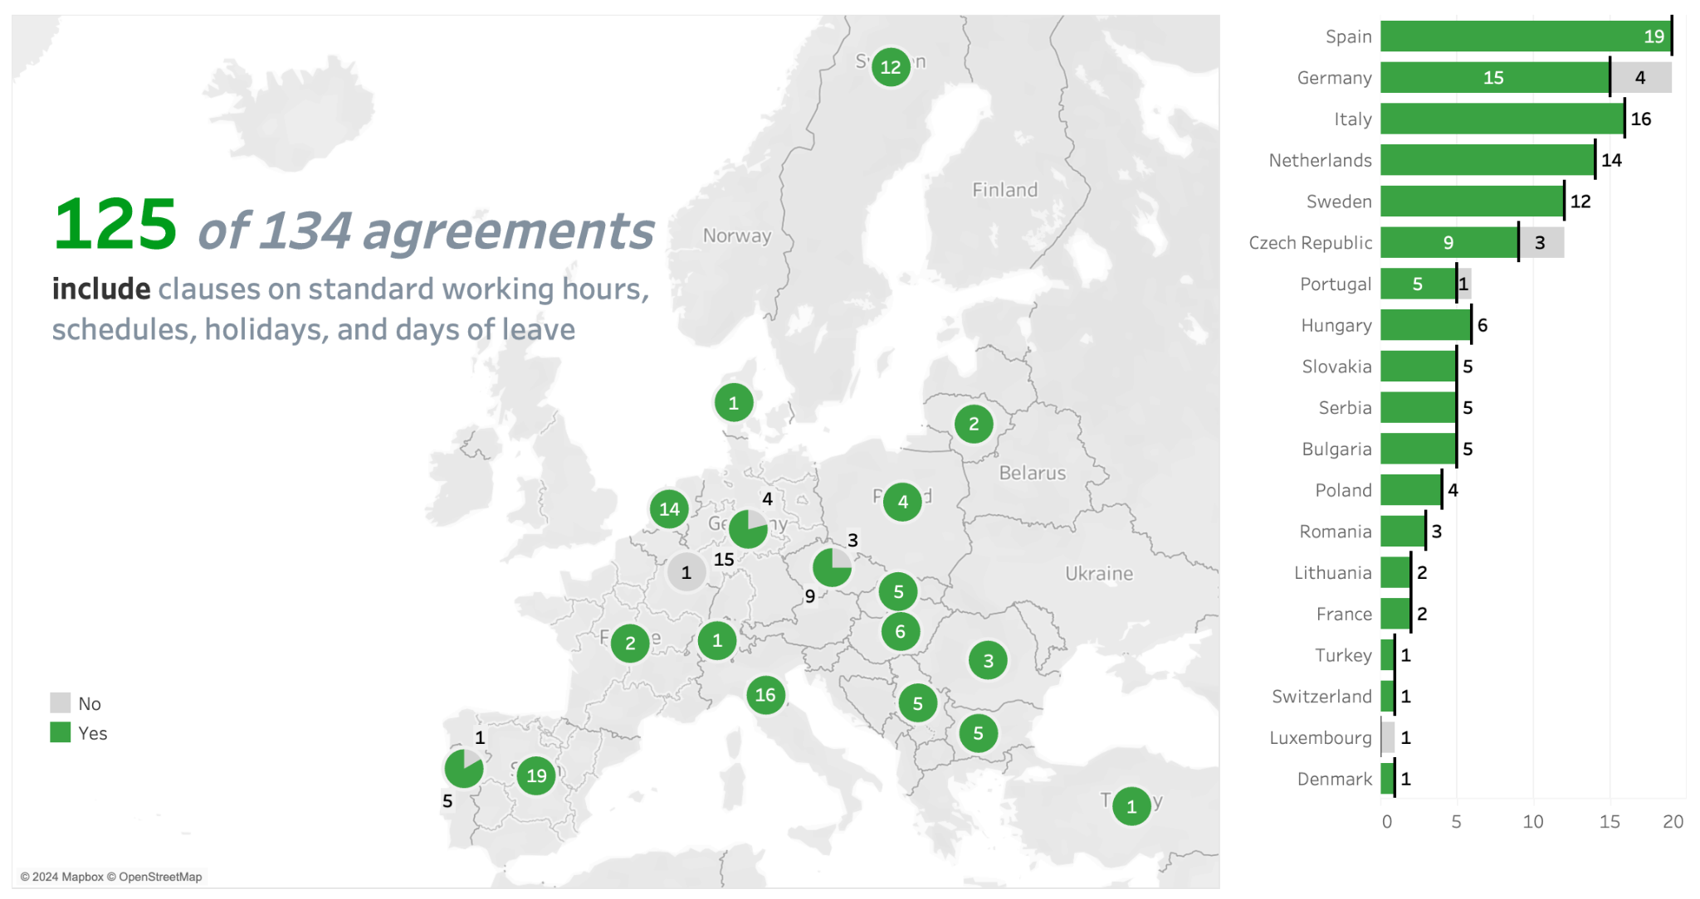
Working hours, schedules, holidays, and days of leave
125 of 134 CBAs refer to clauses related to this topic (93%)
Average working hours per day is: 7.9, weekly 39,3.
Average paid Annual Leave: 24 days

Slide 18
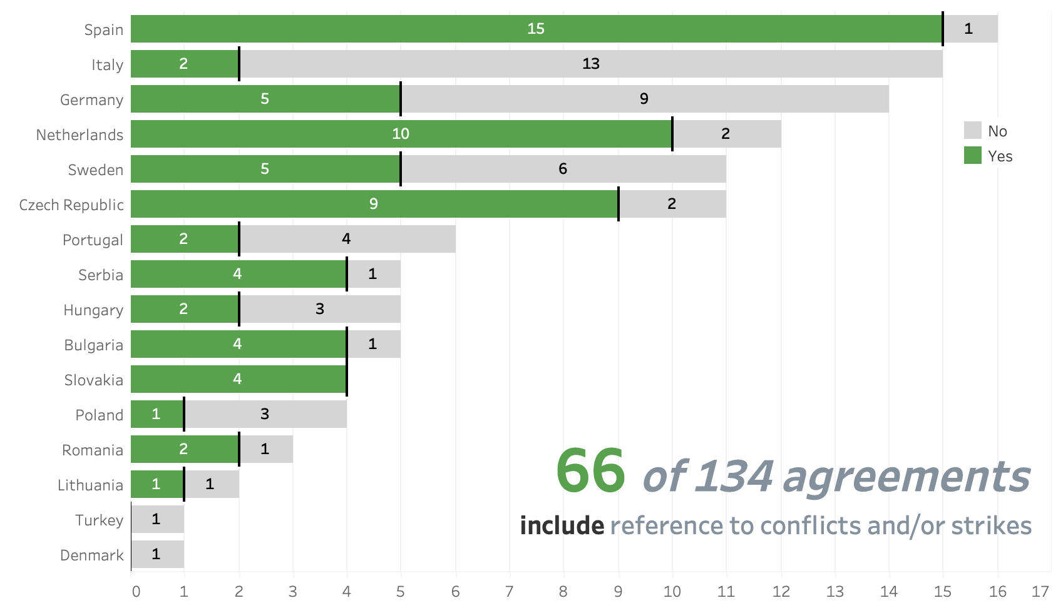
Workers’ Representation & Conflicts (work councils and strikes)
66 of 134 CBAs refer to clauses related to such topics (50%)
Spain stands out as the country having more CBAs referring to such clauses (15/1)

Slide 19
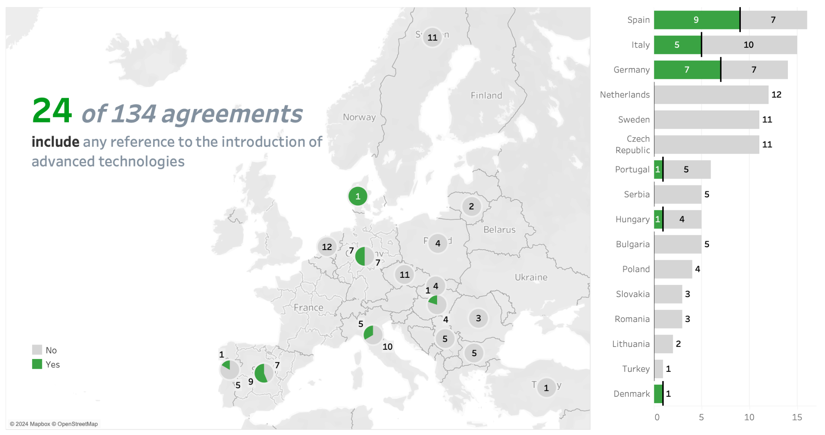
Advanced Technologies (including AI/AM)
Only 24 of 134 CBAs refer to clauses related to the introduction of advanced technologies (18%)
Spain, Germany and Italy are the countries with more chances to contain clauses regarding Advanced Technologies (more than 50% of their agreements)

Slide 20
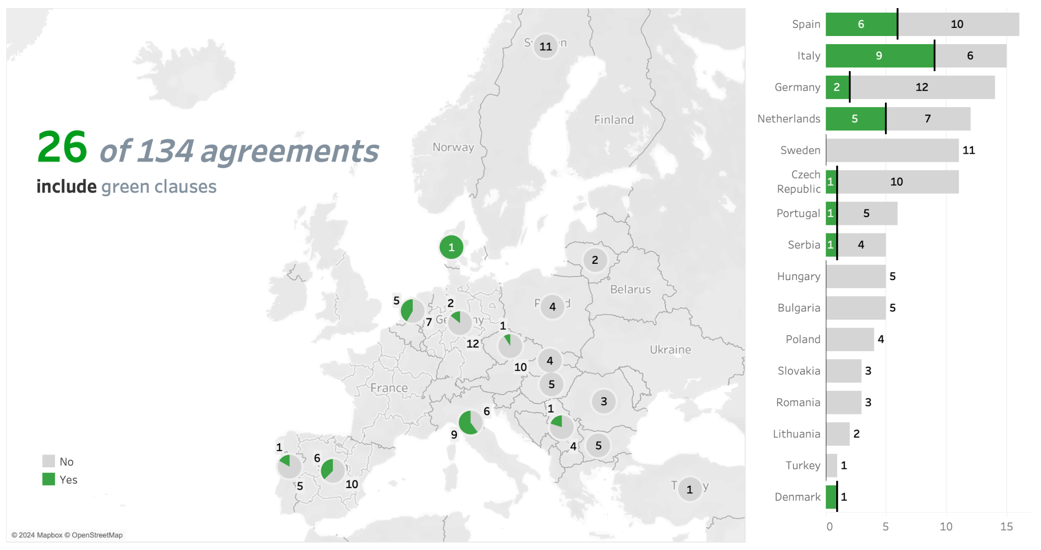
Green clauses
Green clauses contain provisions related to environmental issues, climate change and/or anything that aims at improving the working conditions by providing a greener workspace
Only 26 CBAs of 134 (20%) contain green related clauses, in 8/19 countries

Slide 21
Conclusions
Overall, the European Metal sector agreements are well structured and quite comprehensive, as they substantially cover all the labour macro topics analyzed.
On the other hand, Green clauses and AI/AM contents are less represented than other labour macro topics. DAD issues are relatively recent topics in the public debate (also in CBAs), this might explain their lower coverge in the agreements: in fact, the most recent CBAs have more chances to include such concepts and clauses.
At different levels, both large Companies as well as large National Social partners, have pointed out in their agreements their commitment of including Green and AI/AM clauses in all their CBAs in the future:
- Sustainable practices to achieve climate-neutral production; protection and improvement of the internal and external environment)
- Training for employees on new AI tools, right to disconnect, data protection

Slide 22
Conceptual NOTES:
SAMPLE: the European metal sector CBAs analysis focuses only on the agreements that have been annotated in the framework of the BARMETAL project. The number of CBAs/Country, which have been collected and annotated for the project, are solely based on their availabity and the social partners cooperation in sharing them.
CBAs annotation and analysis focus only on what is explicitly stated in the text of the agreements, regardless of any assumptions and/or what is established by the labour law in other/separate documents.
To see the full CBAs analysis, refer to the report: Phonskaningtyas, I. C., Ceccon, D., Medas, G., Kahancova, M. (2024). BARMETAL Report on the findings of CBAs stipulations. Amsterdam, WageIndicator Foundation [EN]
The annotation and analysis of the CBAs have been performed using the Wageindicator CBAs codebook.*
*See the latest CBAs Database Codebook here: Ceccon, D., Medas, G. (2023). Codebook WageIndicator Collective Agreements Database – Version 6 – October 2023. WageIndicator Foundation, Amsterdam.

Slide 23
THANK YOU!
Gabriele Medas
Manager of the WageIndicator Collective Agreements Database
gabrielemedas@wageindicator.org
*See the latest CBAs Database Codebook available here: Ceccon, D., Medas, G. (2023). Codebook WageIndicator Collective Agreements Database – Version 6 – October 2023. WageIndicator Foundation, Amsterdam.
**WAGEINDICATOR COLLECTIVE AGREEMENTS DATABASE ANNUAL REPORT - 2023

Slide 24
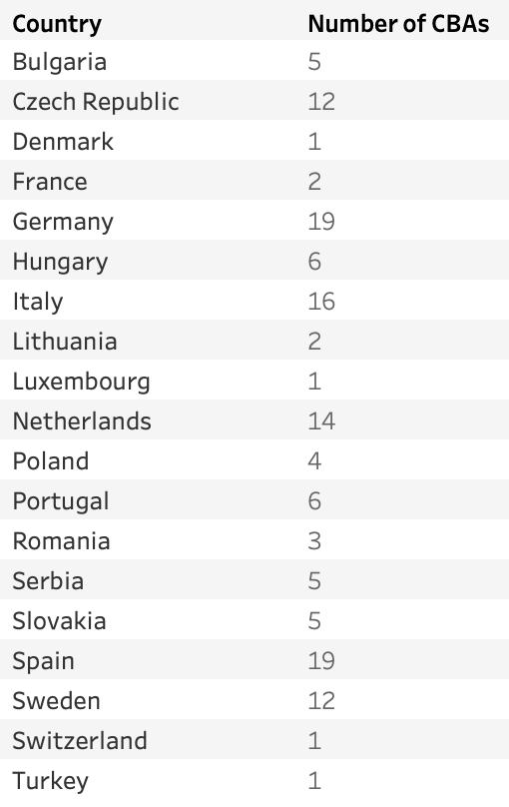
Countries and number of metal sector CBAs analyzed

Slide 25
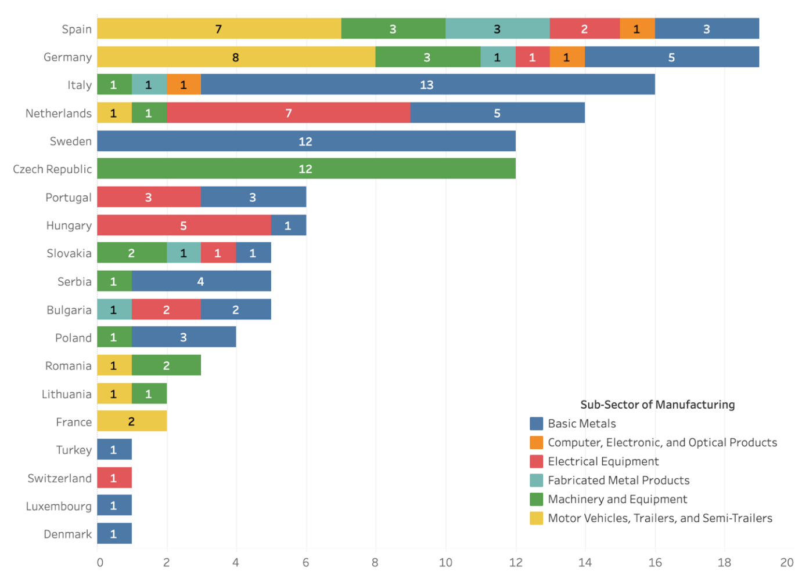
Sectoral and country composition of the collective agreements’ sample in the 6 Metal NACE Codes

Slide 26
Advanced Technologies (AI/AM)

