Slide 1







GA No: 101126476, SOCPL-2022-IND-REL-01
The care sector crisis as a turning point:
Advancing collective bargaining
in the care sector of Central and Eastern European countries
Scientific webinar, 23 June 2025

Slide 2
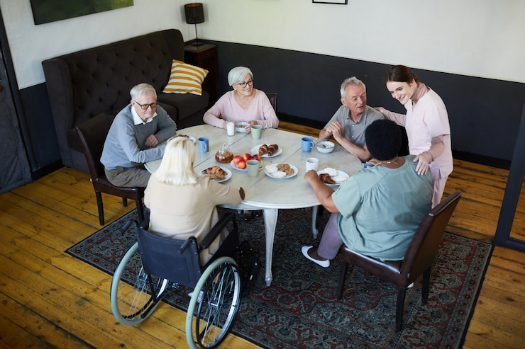
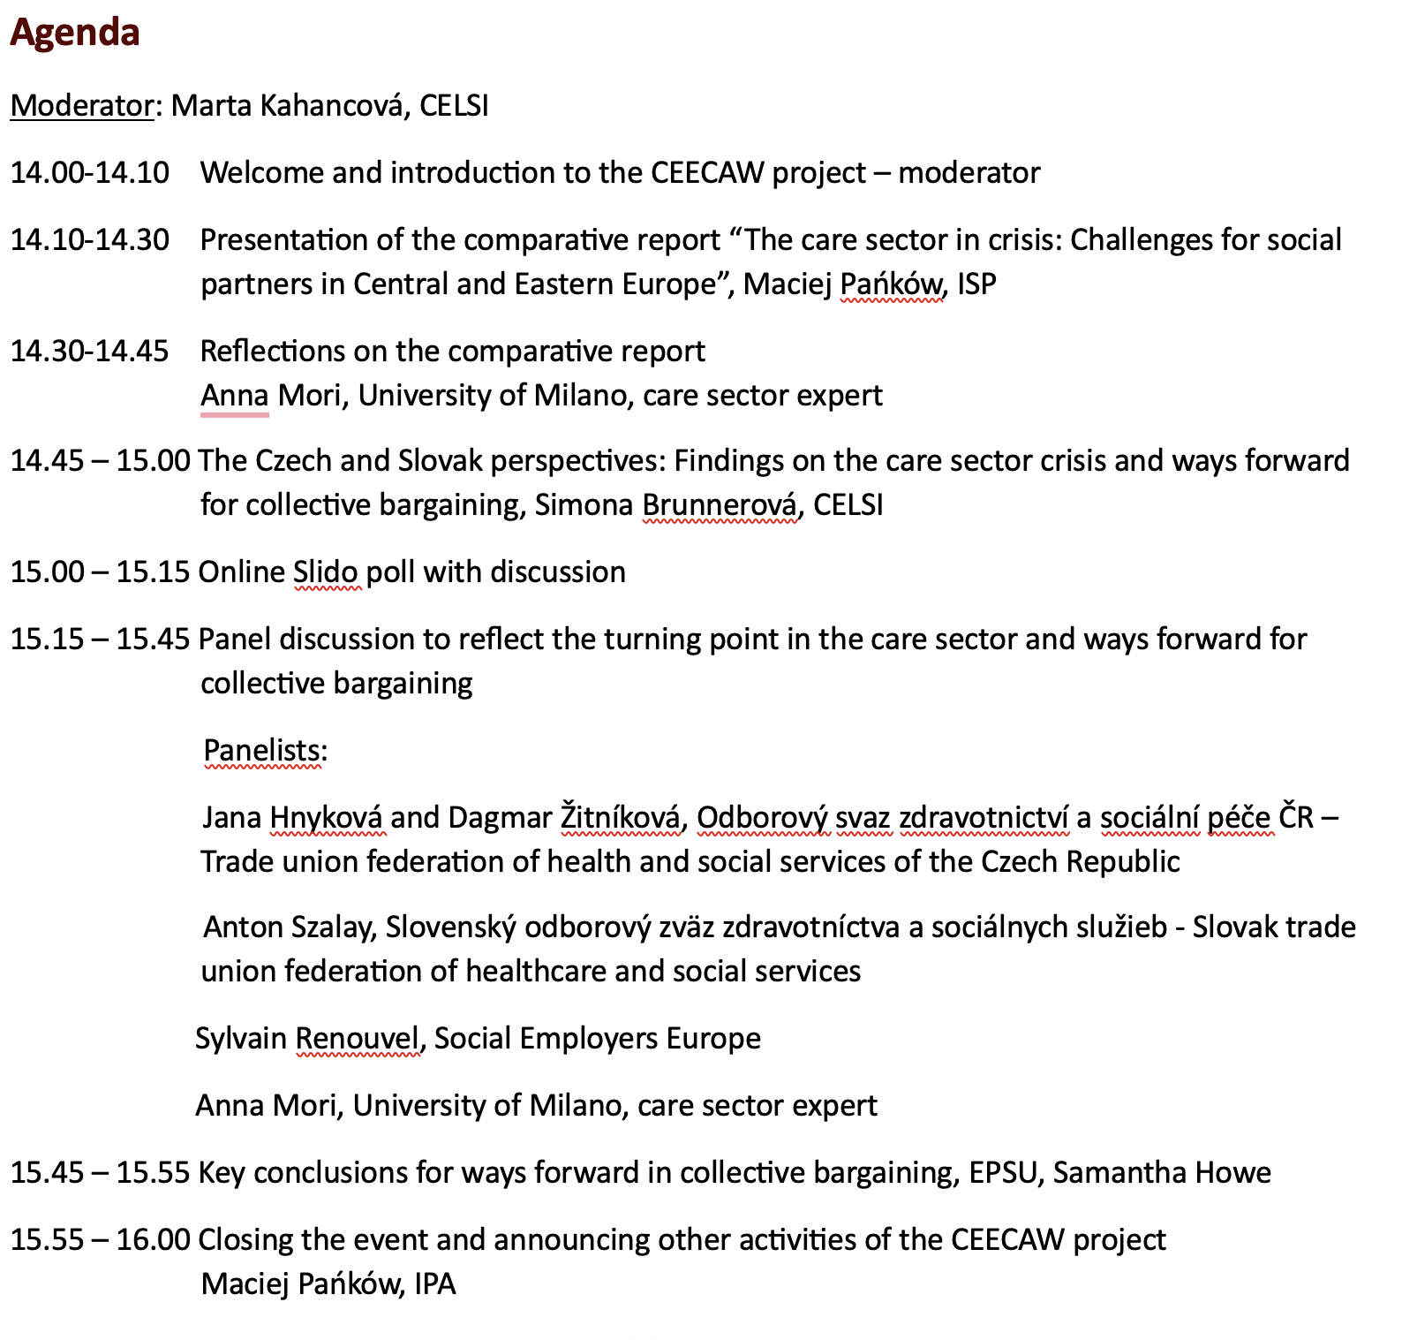


Agenda

Slide 3
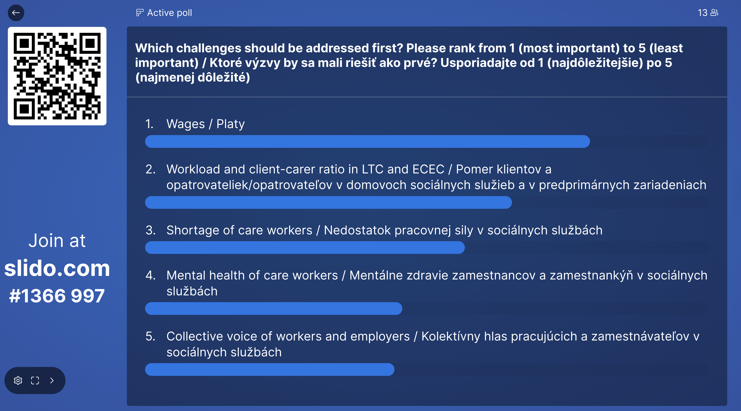
Slido Poll of participants - results
Share your views on priority challenges in the care sector

Slide 4
Panel discussion
Jana Hnyková, Trade Union Federation of Healthcare and Social Work of the Czech Republic (OSZSP ČR)
Anton Szalay, Slovak Trade Union Federation of Healthcare and Social Work (SOZZaSS)
Sylvain Renouvel, Social Employers Europe
Anna Mori, University of Milano

Slide 5

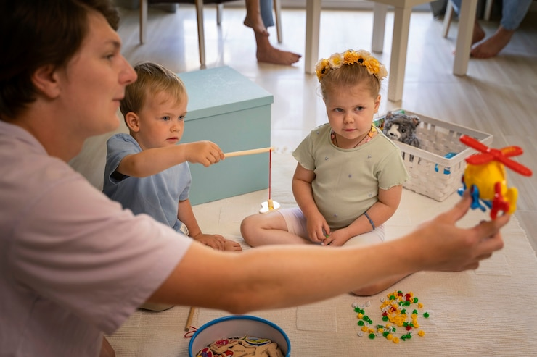

Key conclusions and ways forward
Samantha Howe, European Public Service Union

Slide 6
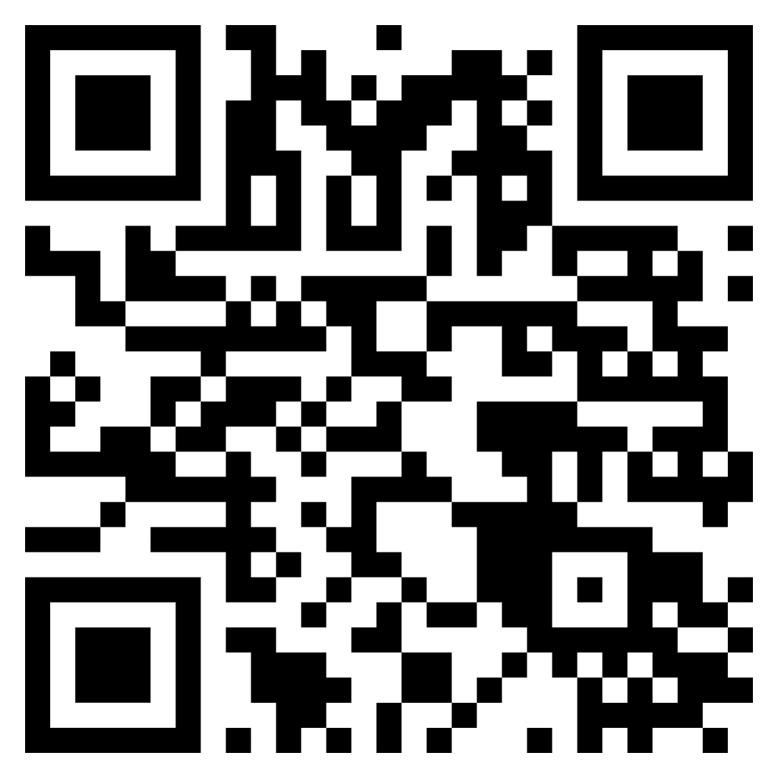
CEECAW website and reports (in English), newsletters in English, Polish, Bulgarian, Slovak, Lithuanian, Serbian
https://www.isp.org.pl/en/projects/ceecaw-challenges-for-organising-and-collective-bargaining-in-care-administration-and-waste-management-sectors-in-central-eastern-european-countries
Concluding words
Maciej Panków
Instytut Spraw Publicznych
Thank you!

